Slide 1
Identifying ID Submissions using Computer Vision
Improving the customer experience in applying for a new digital bank account

Slide 2
Contents
01
Introduction
02
Exploratory Data Analysis
03
Modelling & Deployment
04
Conclusion

Slide 3
01
Introduction

Slide 4

Indonesia has a Huge Untapped Banking Market, but ID Verification is Laborious & Time-Consuming
Scenario: A digital bank in Singapore wants to expand its banking business into the Indonesian market
Opportunity:
Large under-served market: 4th most populous nation, 3rd largest unbanked population¹
Young, tech-savvy & tech-hungry population: median age is 30 years; has the 2nd highest interest level in digital financial services (Southeast Asia)²
Challenge:
No national digital ID: for account opening, laborious & time-consuming ID verification must be done with digital submission of physical documents (i.e. photos)
50%
(~140m) of population yet to have a bank account¹
146m
people are between 15 – 49 years of age³
Problem Statement: manual verification of ID submissions results in poor customer experience
[1] World Economic Forum, Feb 2022, [2] EY, Dec 2022, [3] United Nations Statistics Division Yearbook, 2020

Slide 5
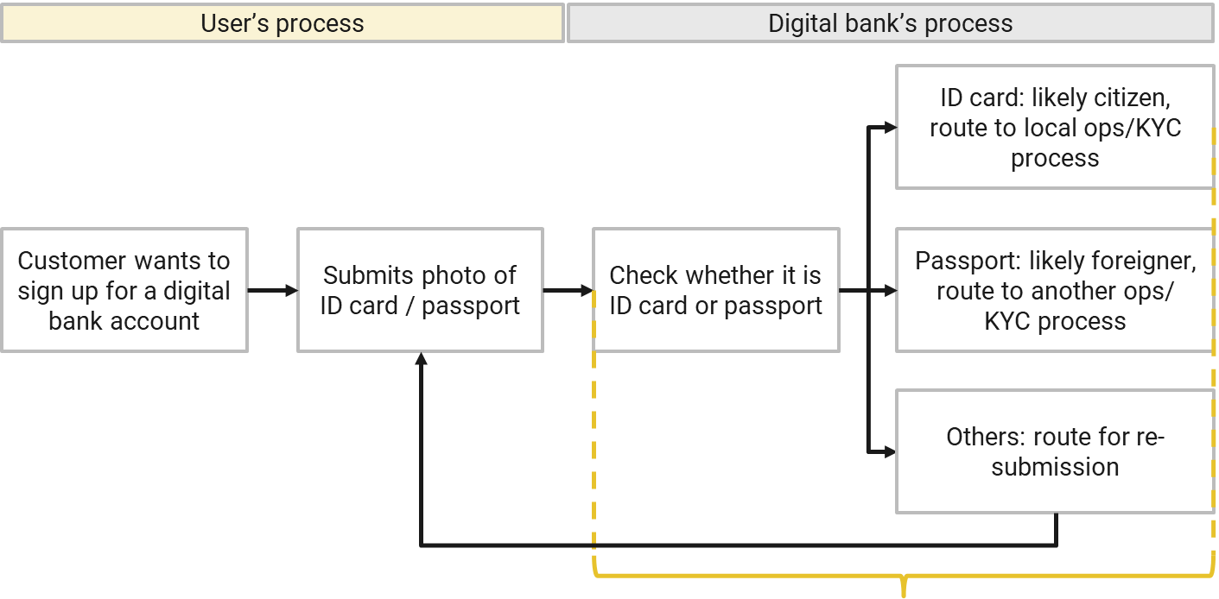


Currently, ID Verification takes: 3 – 5 Working Days
For the customer: tedious experience to wait 3 – 5 days to know whether submission is successful or not
For the bank: labour intensive, time-consuming
Processing time: 3 – 5 working days⁴
[4] as reference: an incorrect photo submission to Singapore’s ICA may double the process time (The Straits Times, May 22): 2 weeks for NRIC, 4 weeks for passport (ICA, n.d.)

Slide 6
Goal: Reduce to <30 Seconds for Each Submission
To enable process automation & process acceleration, the bank tasked me to develop a model to distinctly identify ID cards & passport:
Multi-class object detection in images
Processing time: <30 seconds

Slide 7








Approach: To Train YOLOv5 Model on ID Documents
01
02
03
Label & Analyse Dataset
Model Training
Model Deployment via Streamlit
As proof-of-concept, to use artificially-generated ID cards and passports from East Europe, North-West Asia
Use YOLOv5 for its state-of-the-art inference speed, good accuracy performance & ease of use
Use Streamlit to illustrate model prediction capability – users can choose from a selected set of photos, or upload their own

Slide 8
02
Exploratory Data Analysis (EDA)

Slide 9
Dataset: 1K photos from East Europe & North-West Asia⁵
 | Train 600 photos | Validation 200 photos | Test 200 photos
ID cards | 300 from Slovakia, Spain, Finland (100 each) | 100 from Estonia | 100 from Albania
Passports | 300 from Latvia, Russia, Greece (100 each) | 100 from Serbia | 100 from Azerbaijan
Mock ID documents: from East Europe and North-West Asia, each with unique text fields and artificially generated faces
Separated nationalities: Train, validation & test datasets each have unique nationalities to prevent data leakages
Resized: all photos were resized to 640 x 640 pixels for YOLO
[5] More details in Annex

Slide 10
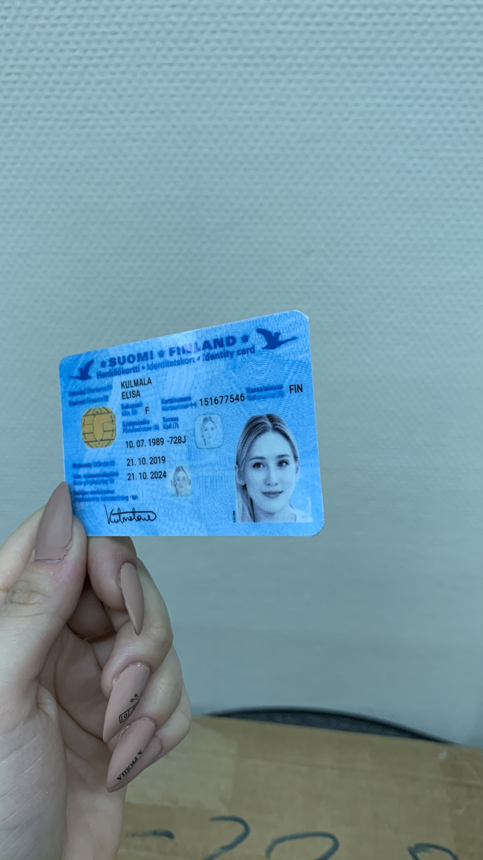
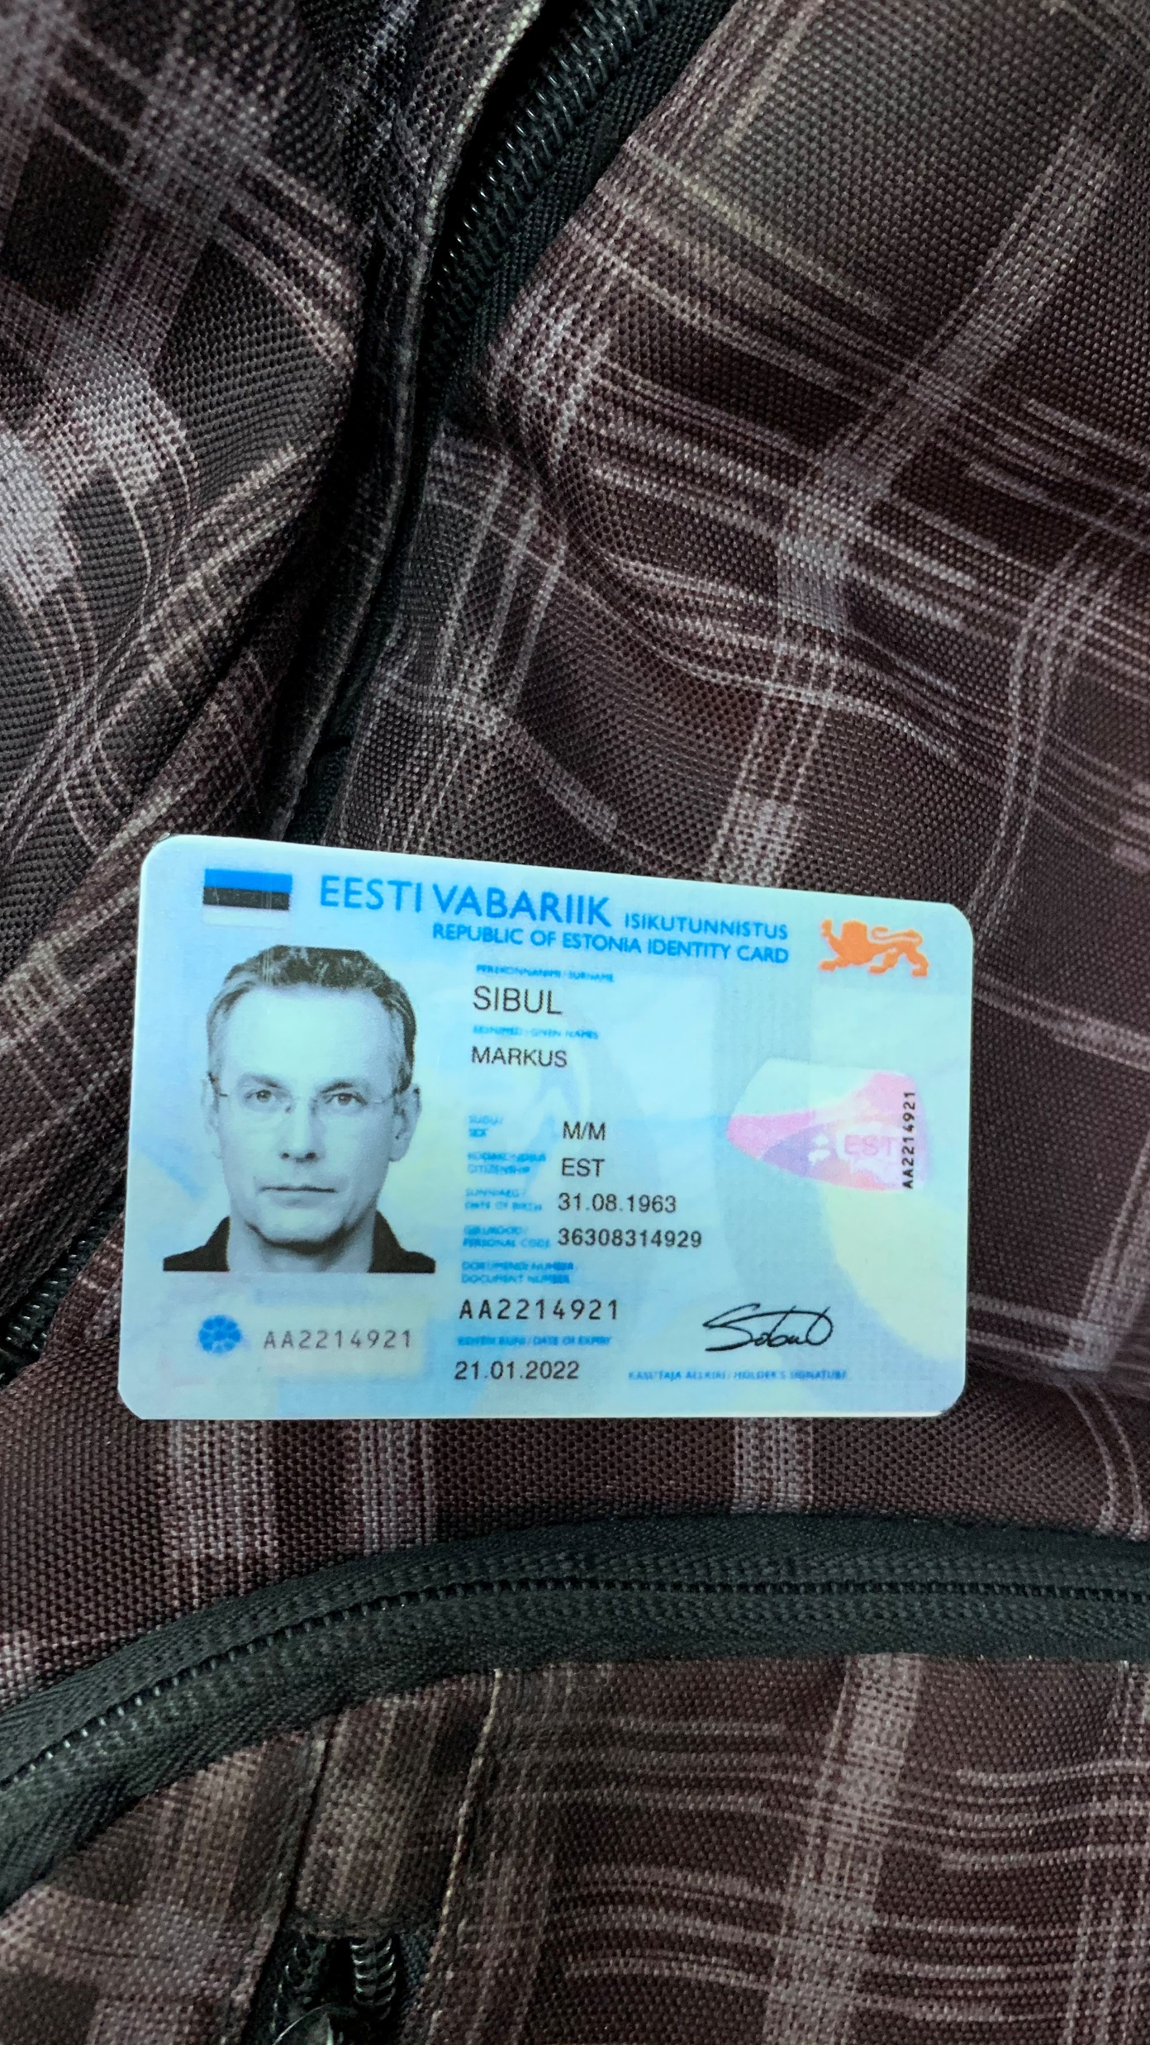
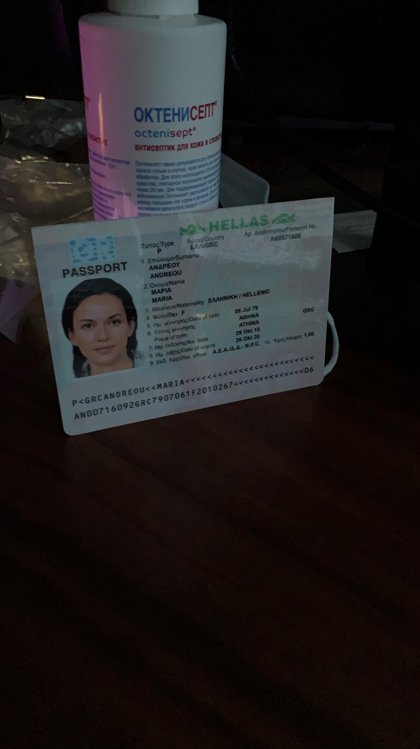
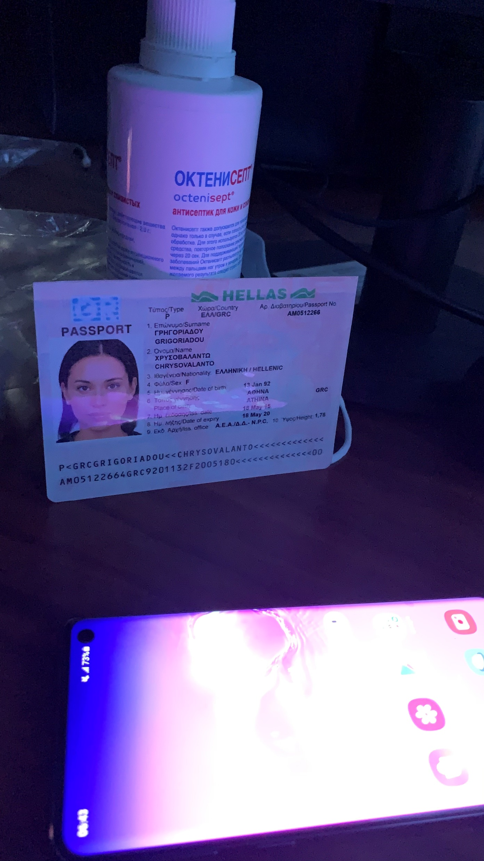
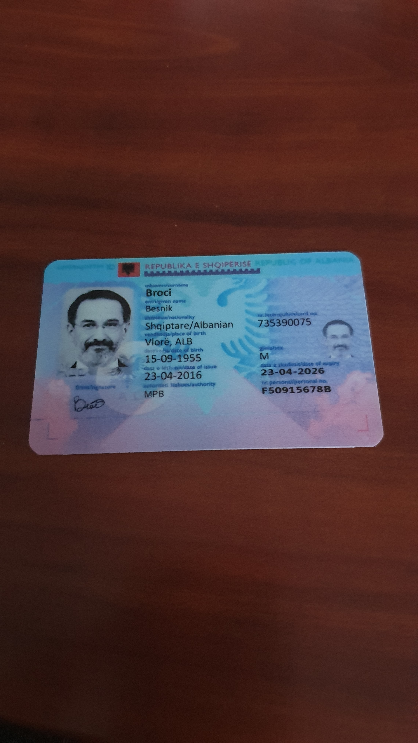
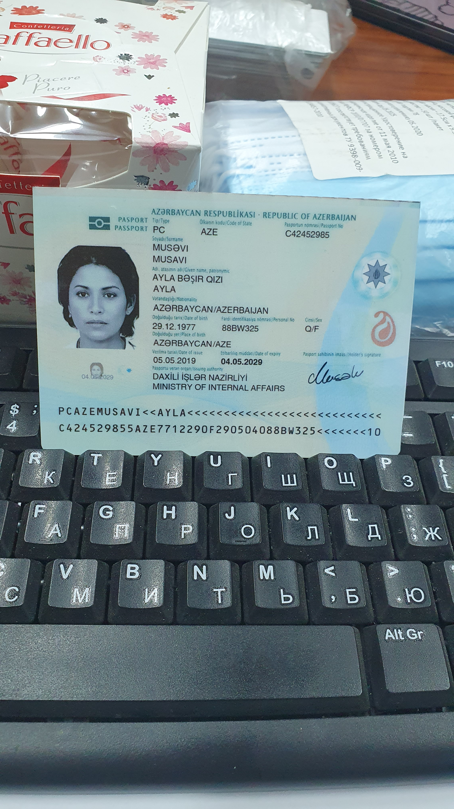
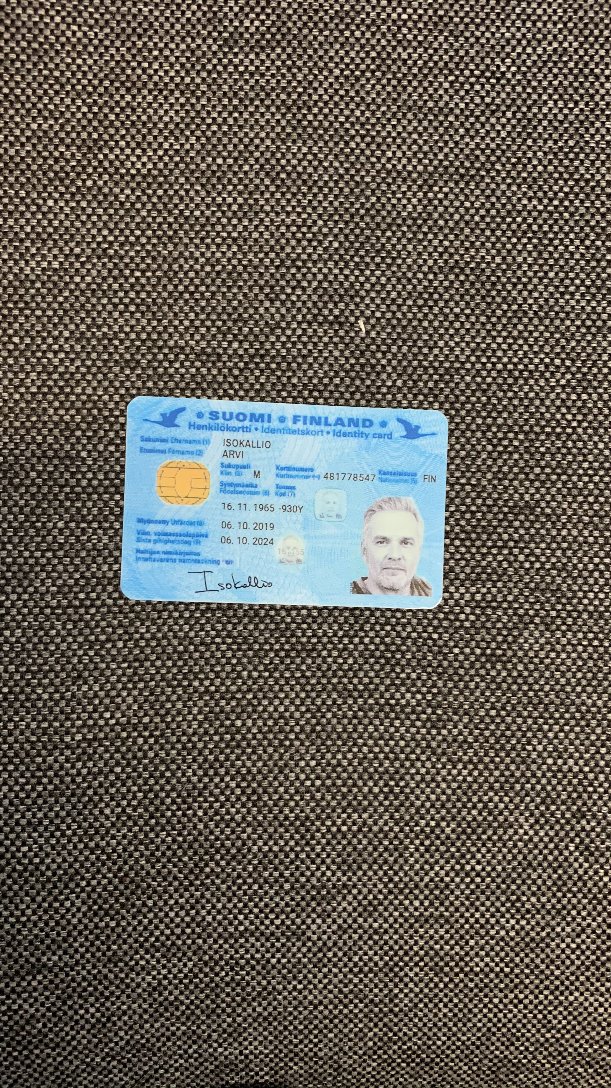
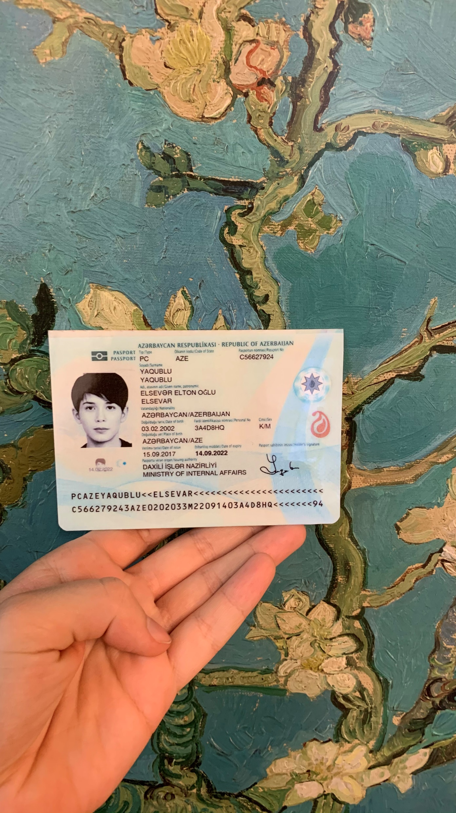
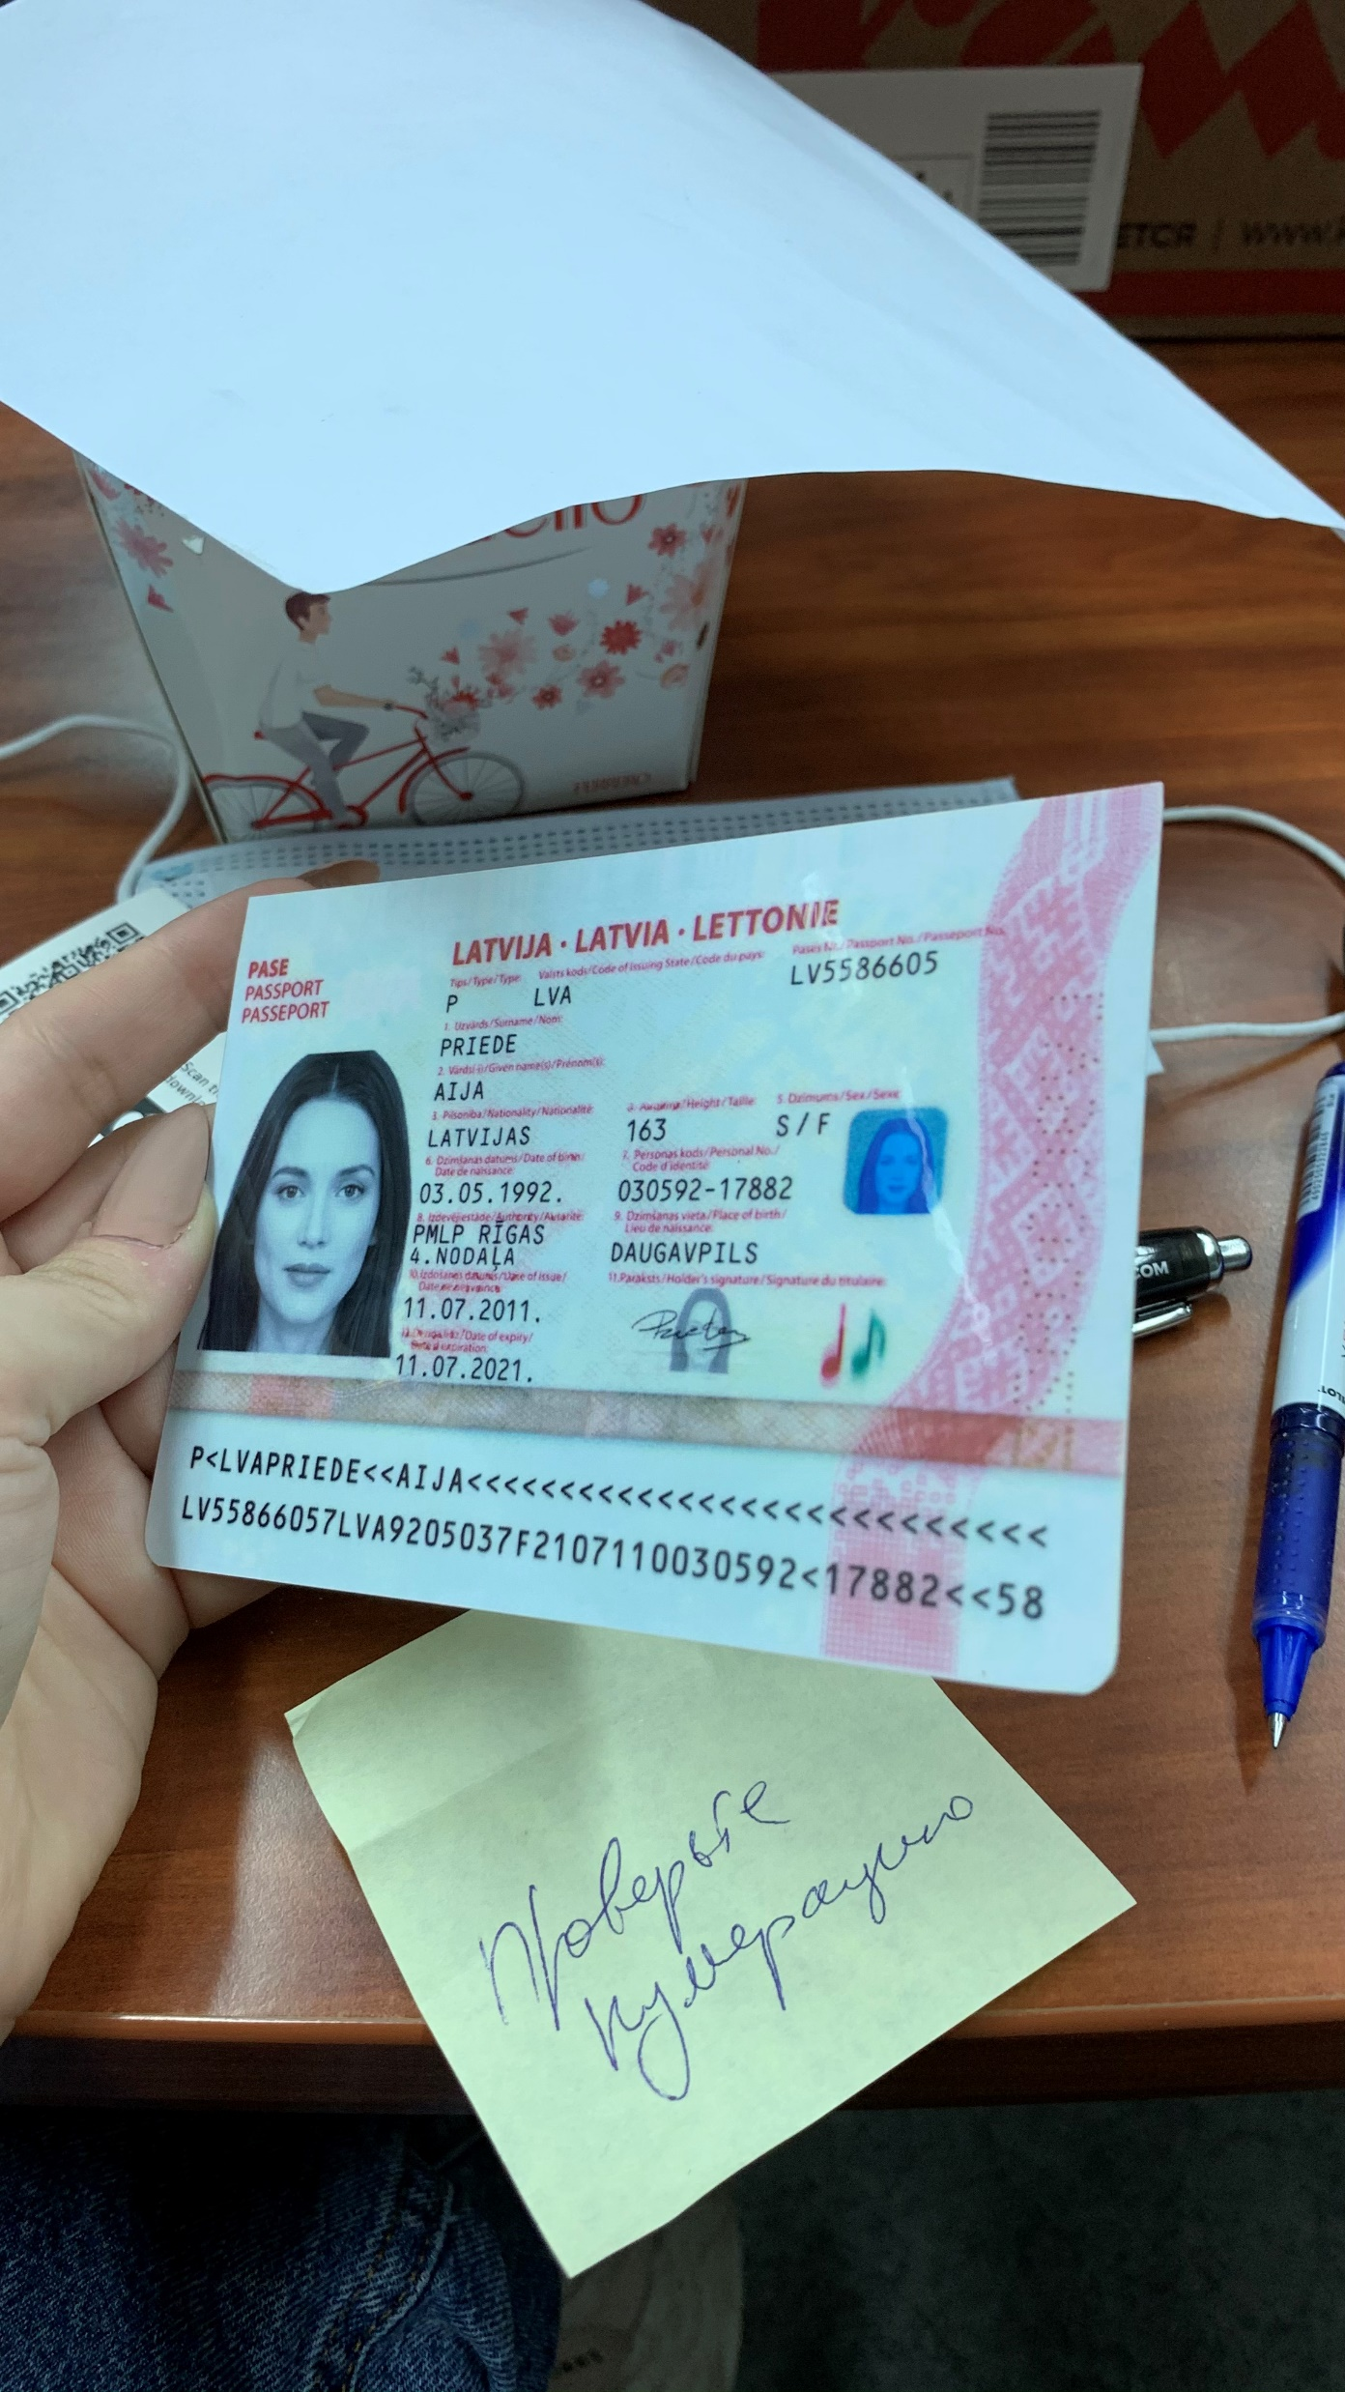
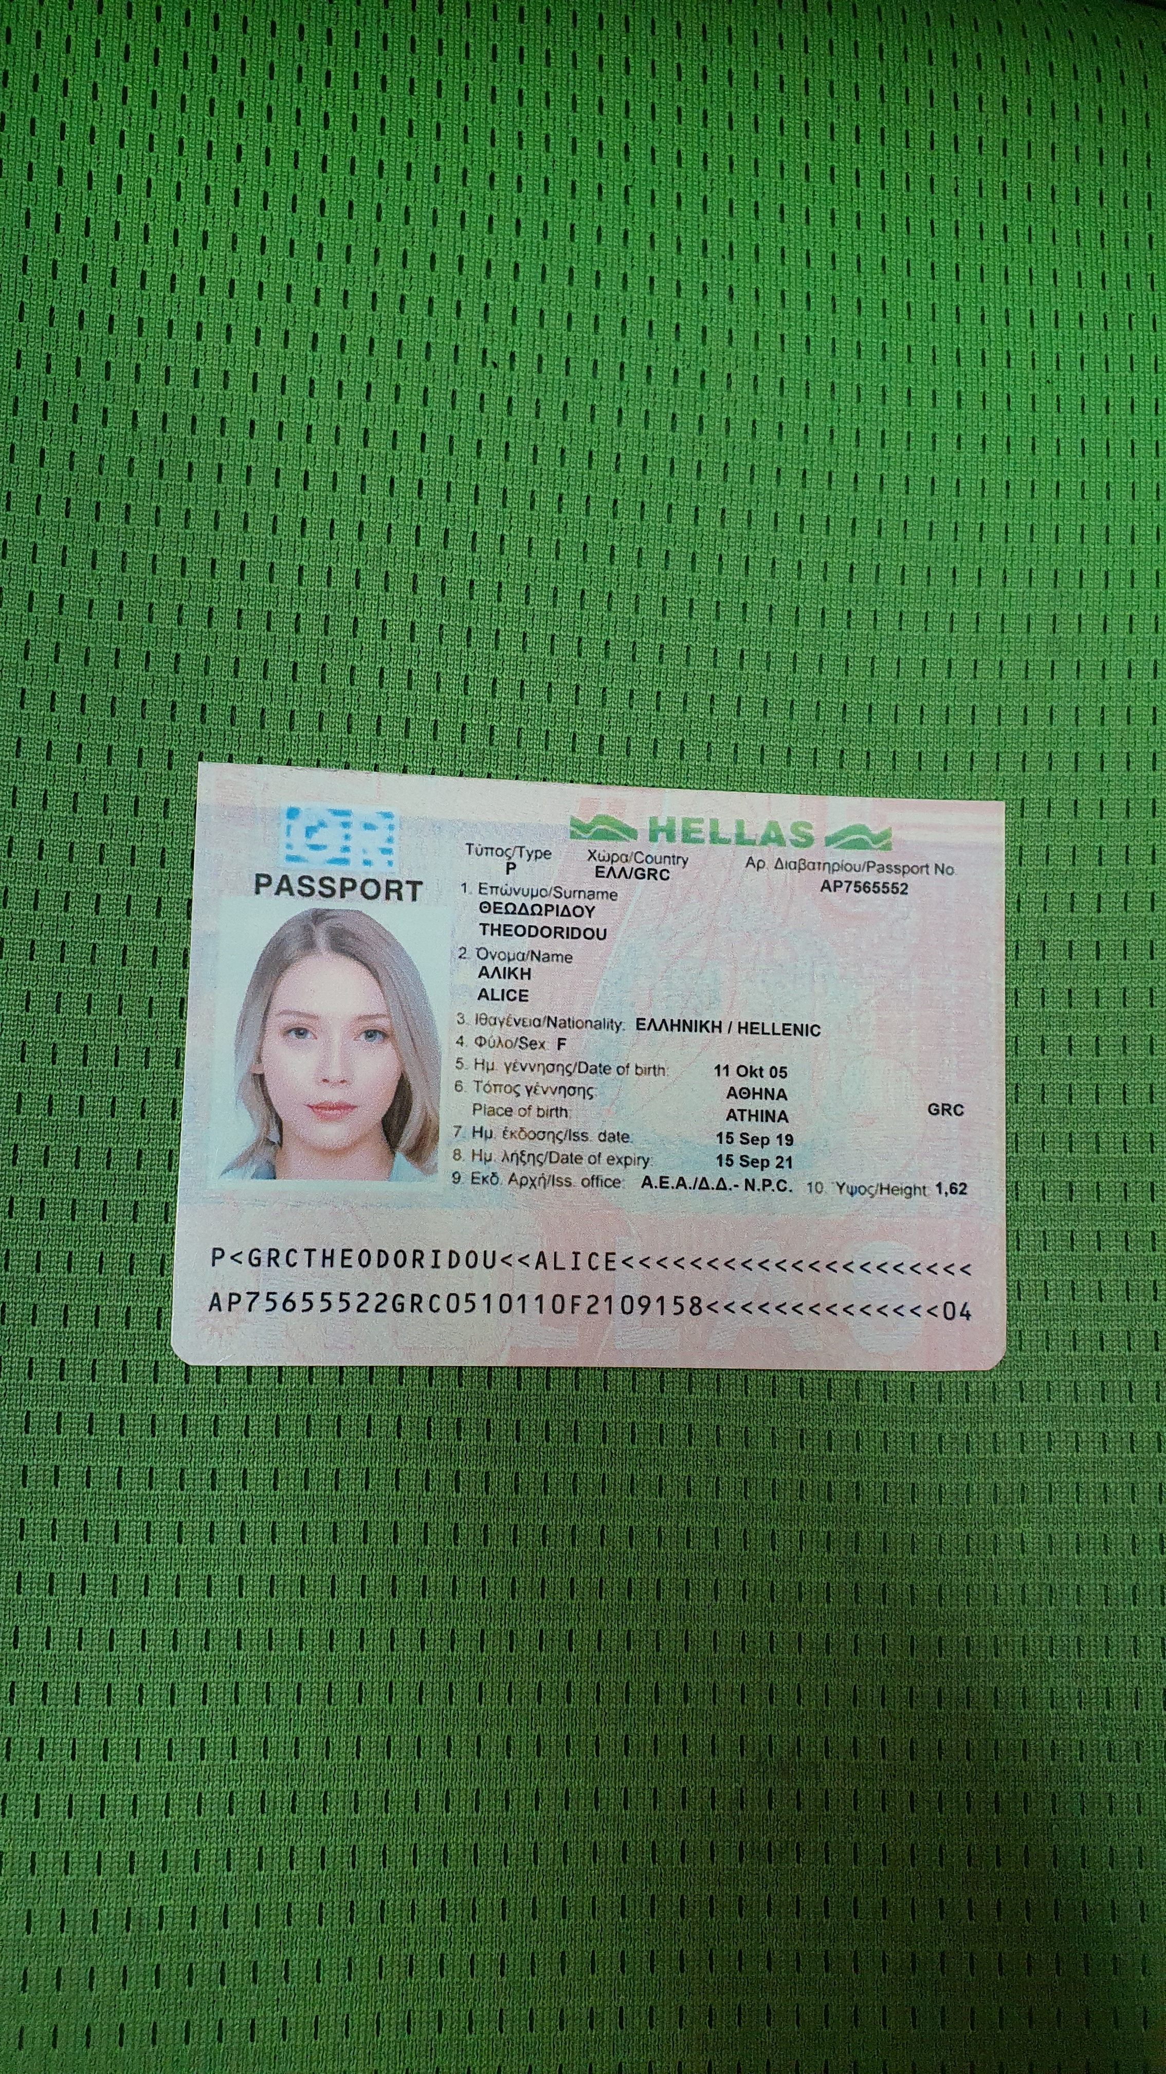
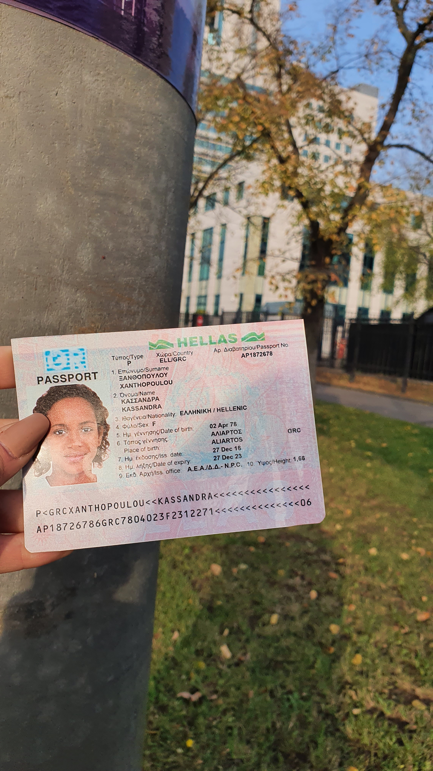
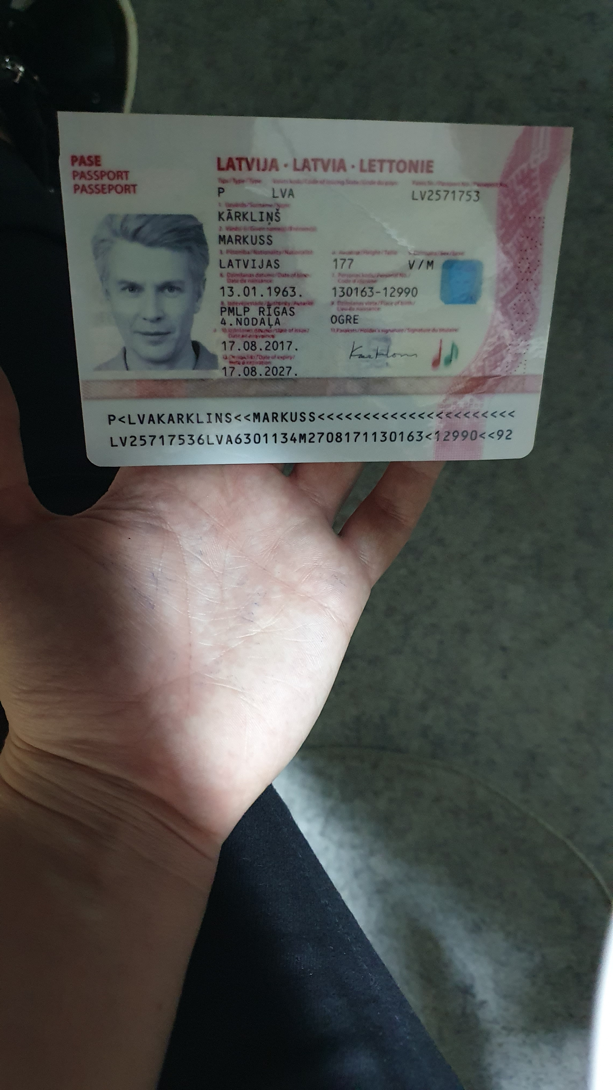
Dataset: Illustration* (1)
Normal
Different background
Different brightness
*Illustrated before photo resize to 640 x 640 pixels

Slide 11
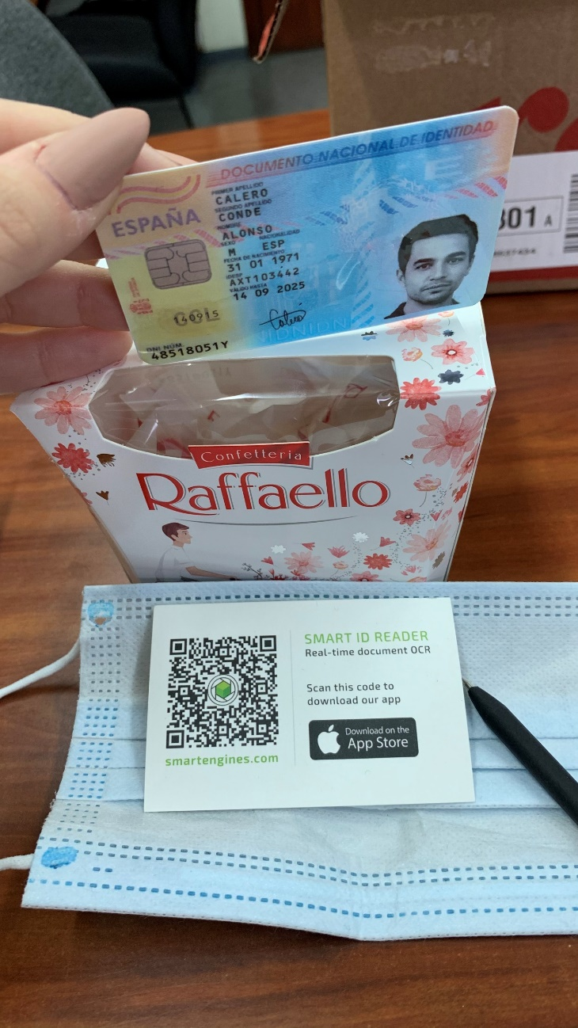
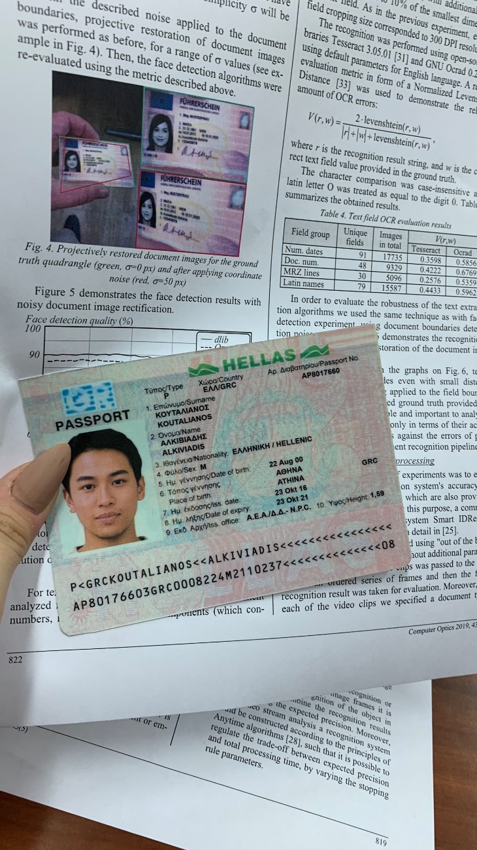
Dataset: Illustration (2)
Multiple cards
Fake ID in background

Slide 12
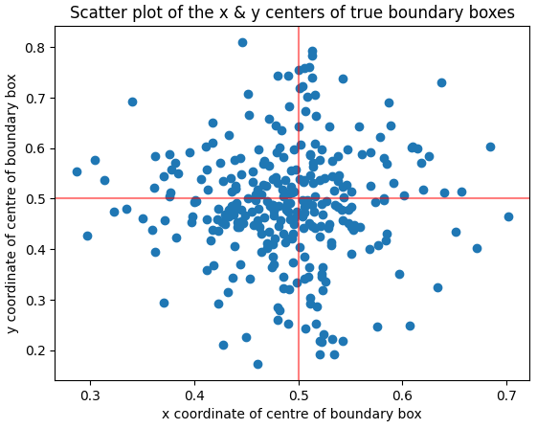
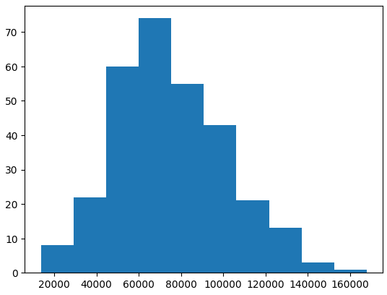
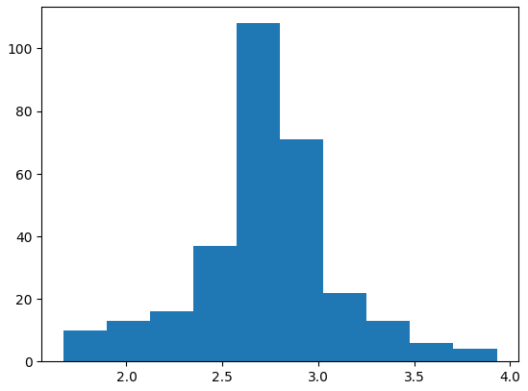
EDA: Training ID Cards are Usually in the Center, 10-20% of Full Photo Size, have Standard ID Aspect Ratio
 | Scatterplot of Boundary Box centres | Histogram of Boundary Box Area | Histogram of Boundary Box Aspect Ratio
Graphs
Analysis | ID cards usually in centre of photo & along the red lines → trained model may be weak in identifying cards in photo corners | No samples near 409,600 pixels (640 * 640) → trained model may be weak in identifying close-up photos of ID cards | Most hover between 2.5 – 3.0 (standard is 2.6 for an ID card*) → trained model may be weak in identifying rotated ID cards
50,000 – 100,000 pixels (10 – 20% of a full 640*640 photo)
*ID card’s standard aspect ratio of 2.6 is after resizing photos to 640 * 640 pixels
EDA references: Neptune.AI, Kaggle samples

Slide 13
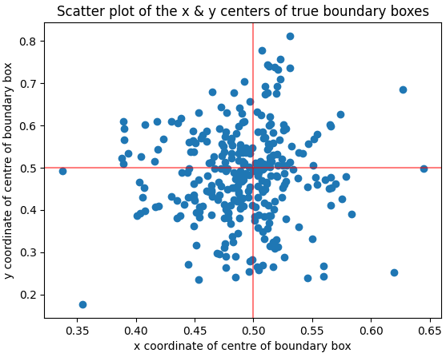
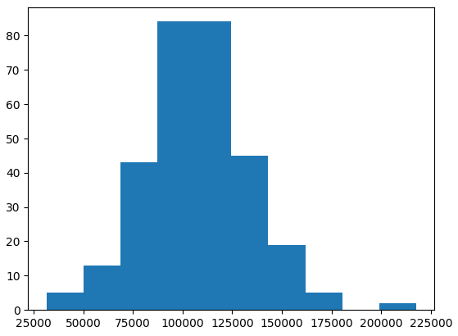
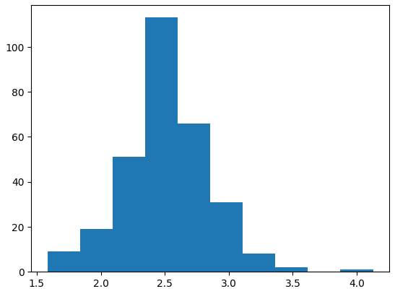
EDA : Training Passports are Similar to ID Cards
 | Scatterplot of Boundary Box centres | Histogram of Boundary Box Area | Histogram of Boundary Box Aspect Ratio
Graphs
Analysis | Passports usually in centre of photo & along the vertical red line → trained model may be weak in identifying passports in left, right & photo corners | No samples near 409,600 pixels (640 * 640) → trained model may be weak in identifying close-up photos of passports | Most hover around 2.5 (standard is 2.6 for an passport*) → trained model may be weak in identifying rotated passports
80,000 – 140,000 pixels (20 – 35% of a full 640*640 photo)
*Passport’s standard aspect ratio of 2.6 is after resizing photos to 640 * 640 pixels

Slide 14
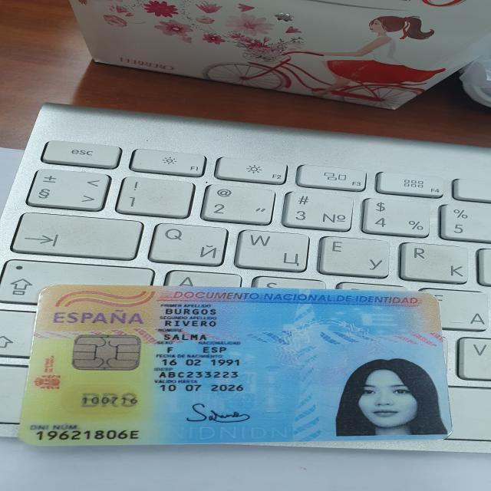
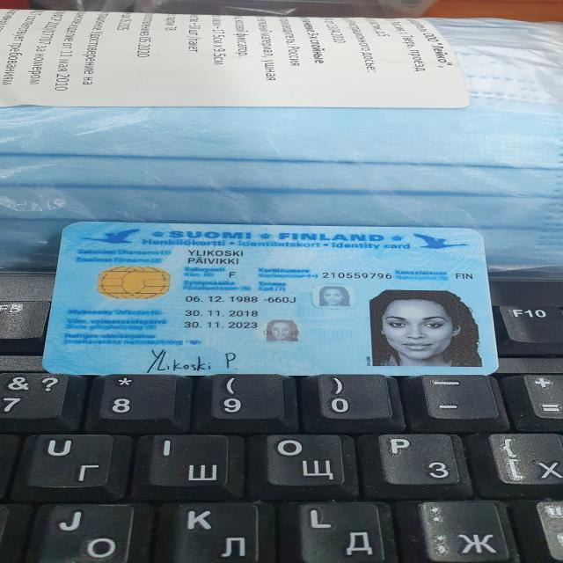
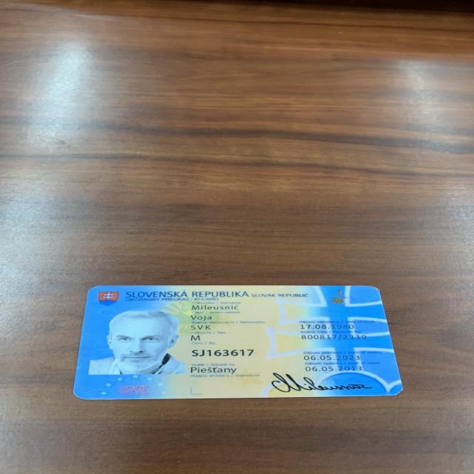
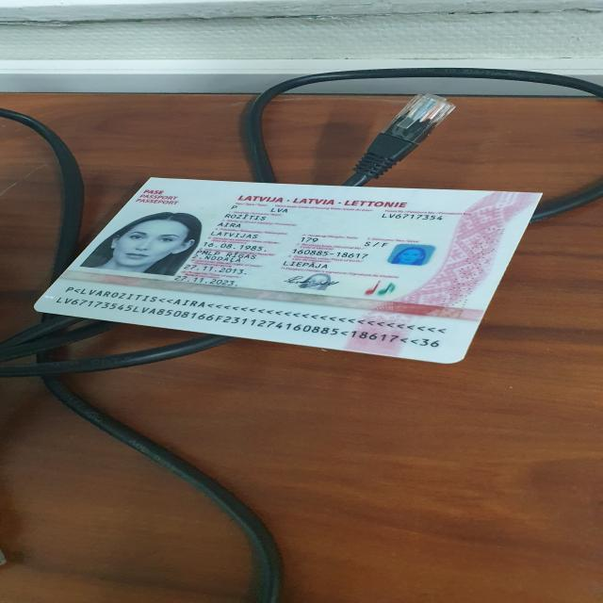
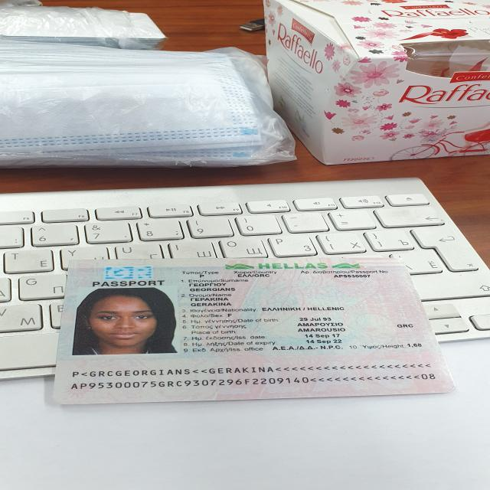
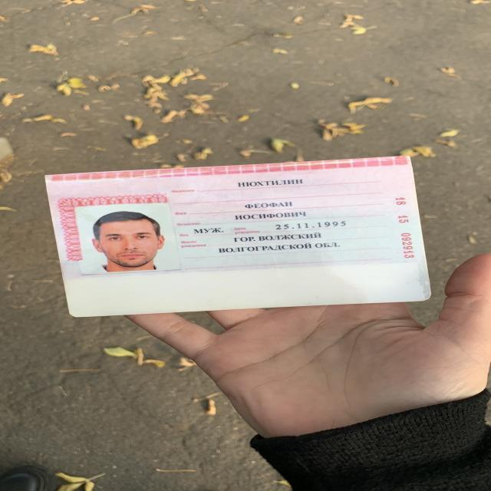
EDA : Training ID Cards, Passports’ Colour Themes
ID Cards: Blue, Yellow
Passports: White, Pink
Spain
Finland
Slovakia
Latvia
Greece
Russia
EDA Takeaway: to explore data augmentation for training dataset to increase sample variations

Slide 15
03
Modelling & Deployment

Slide 16
Modelling Overview
 | Baseline Model | Improved Model 1 | Improved Model 2 | Improved Model 3
Dataset | 1000 photos (600 train, 200 validation, 200 test) |  |  | 1600 photos (1200 train, 200 validation, 200 test)
Augmentation on training data | None | Colours: hue, saturation, brightness⁶ Image translation, scale, flip left-right, mosaic⁷ | Colours: hue, saturation, brightness Image translation, scale, flip left-right, mosaic⁷ Rotation, shear⁷ | Colours: hue, saturation, brightness Image translation, scale, flip left-right, mosaic⁷
Model training, validation | YOLOv5 Large^{8,9}: Batch size = 8 (limited by hardware¹⁰) Epochs = 100 Starting weights = pretrained weights on COCO 2017
Model testing | Best weight from training-validation Confidence threshold = 0.7 With test-time augmentation
[6] Detailed explanation of colour augmentation in annex
[7] Detailed explanation of dimensional augmentation in annex
[8] YOLO performance over other models in annex, YOLOv5l performance over other variants in annex
[9] Reference for training parameters for small dataset by Ultralytics, May 2022
[10] Hardware used: Intel i5-12400F, RAM 16GB, Nvidia RTX 3060

Slide 17
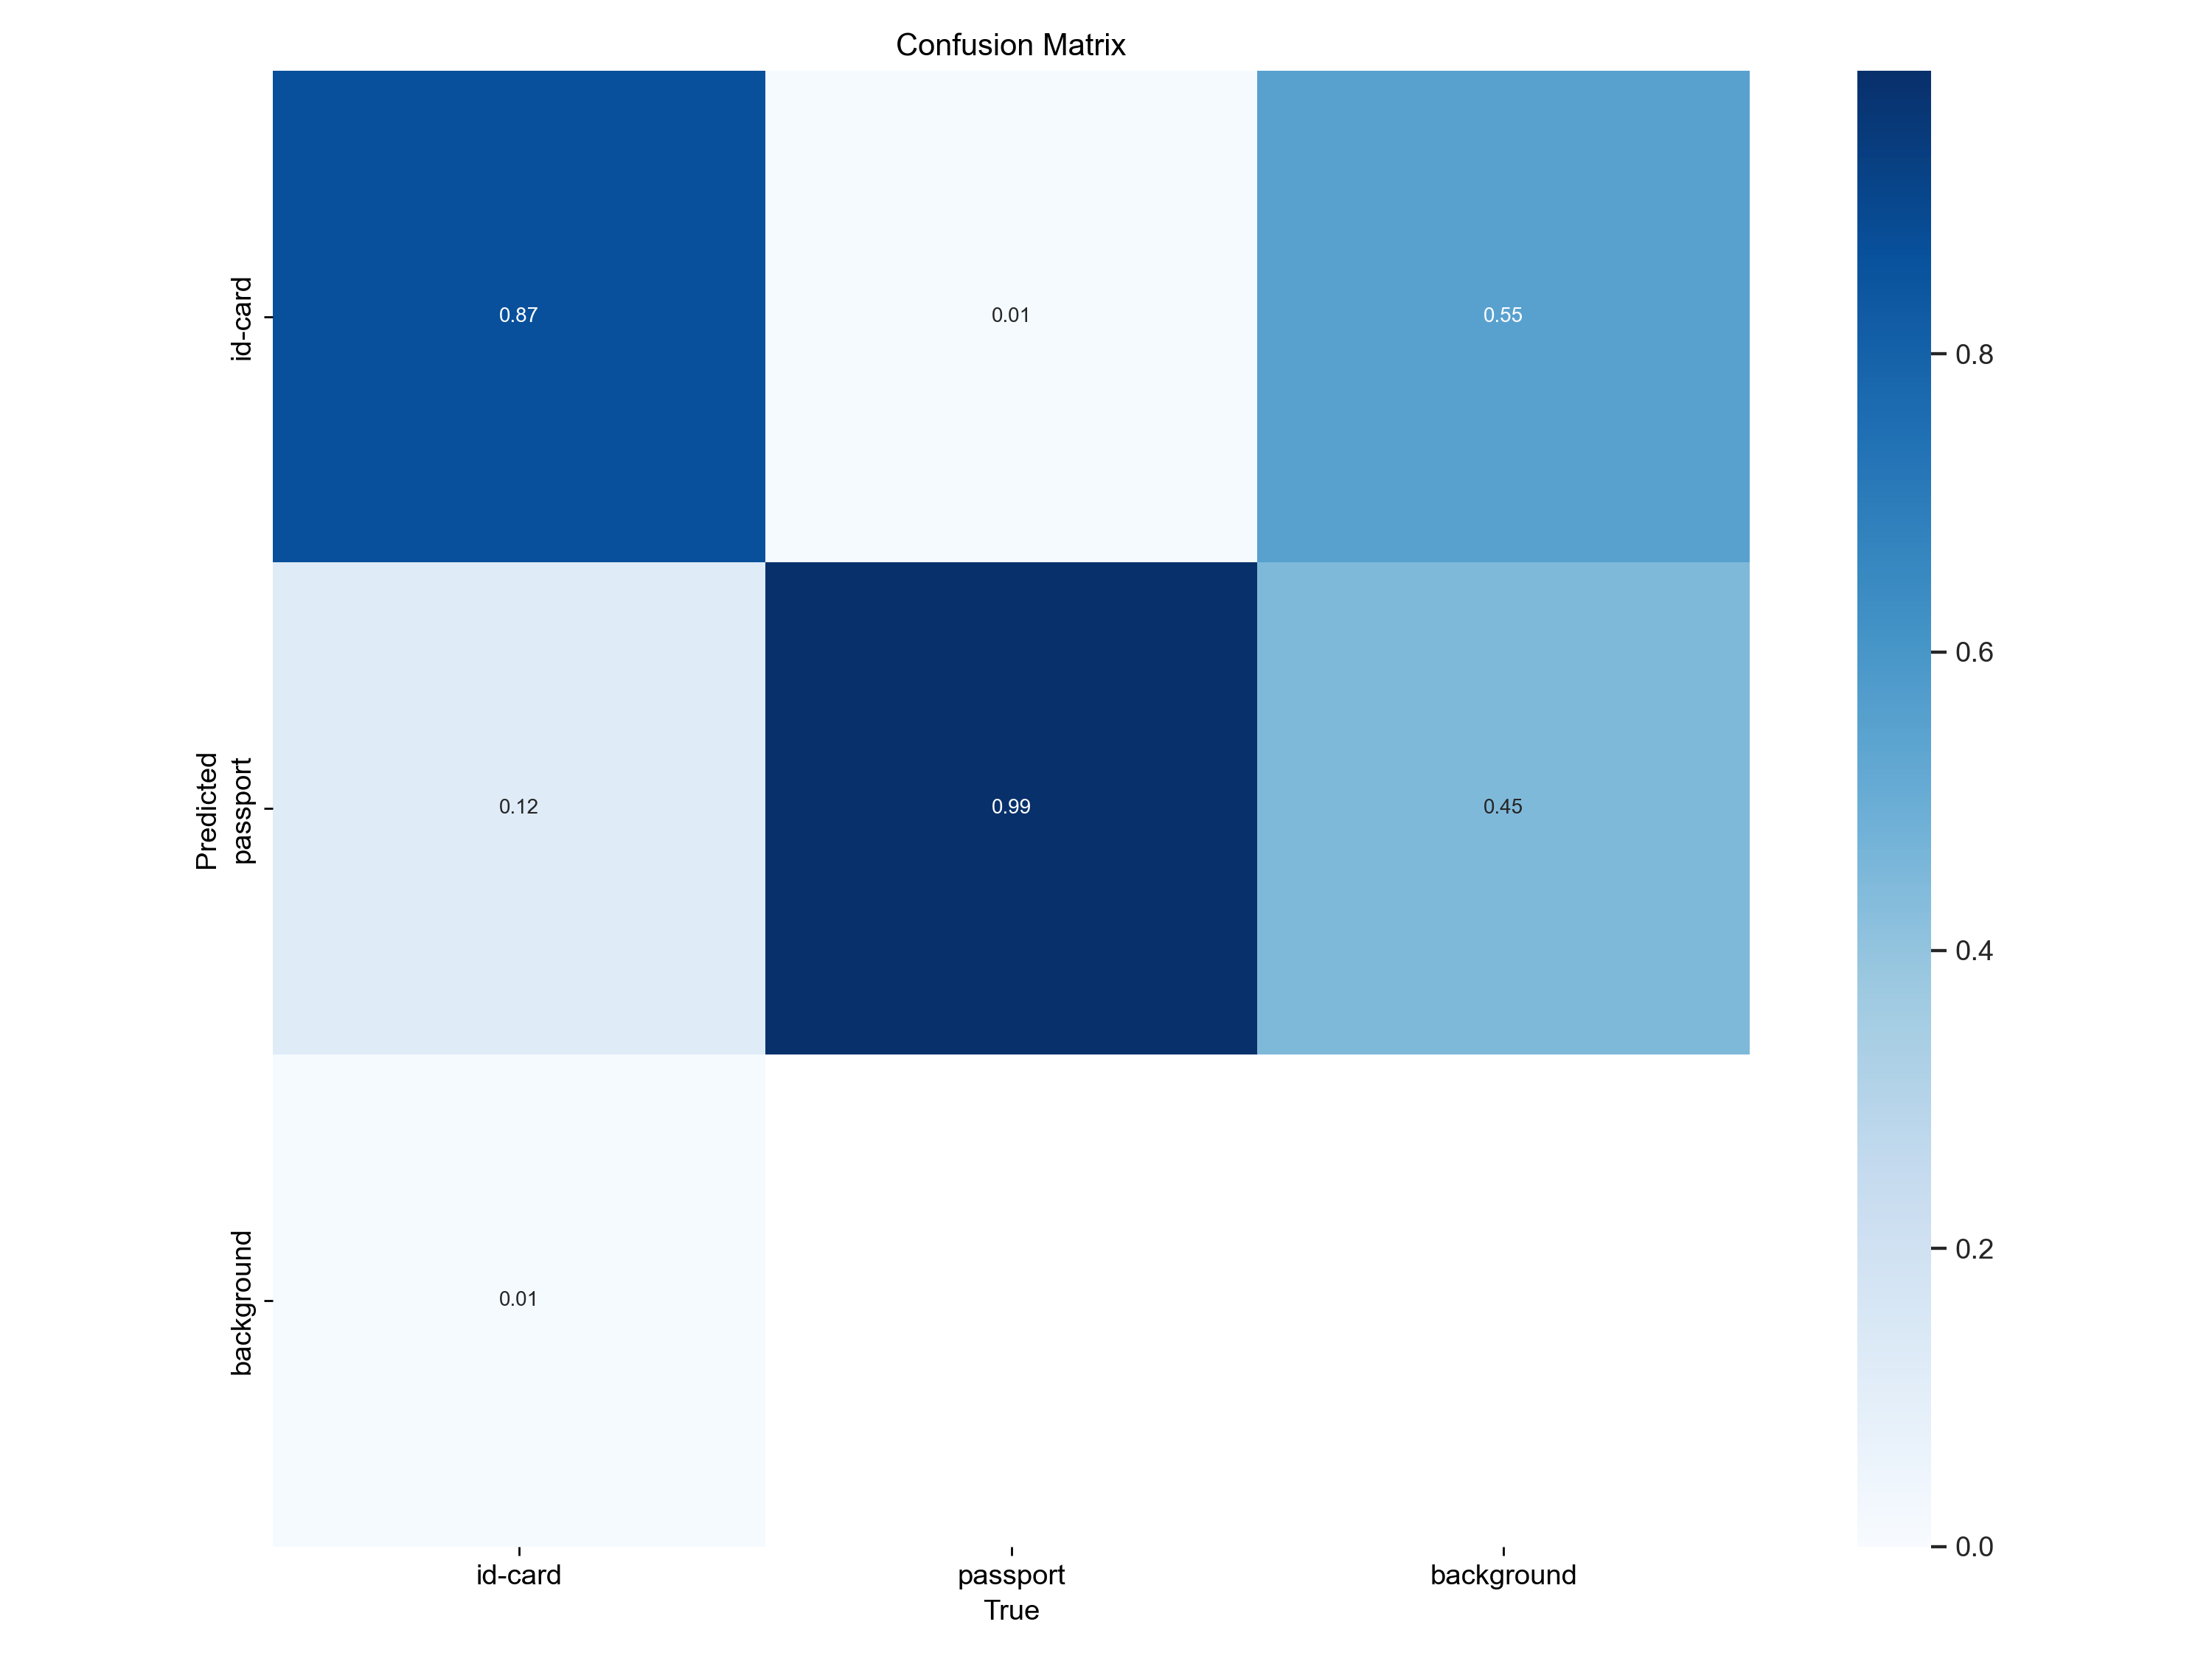
Baseline Model
Validation Scores
Test Scores
 | ID Cards | Passport
Correctly identified | 99 | 62
Wrongly identified as the other class | 1 | 25
Wrongly identified as background | 0 | 13
Analysis for Train-Val:
Did well for passport, did decently for ID card
Identified some background as ID card/Passport
Analysis for Test:
Performed poorly for passport prediction

Slide 18
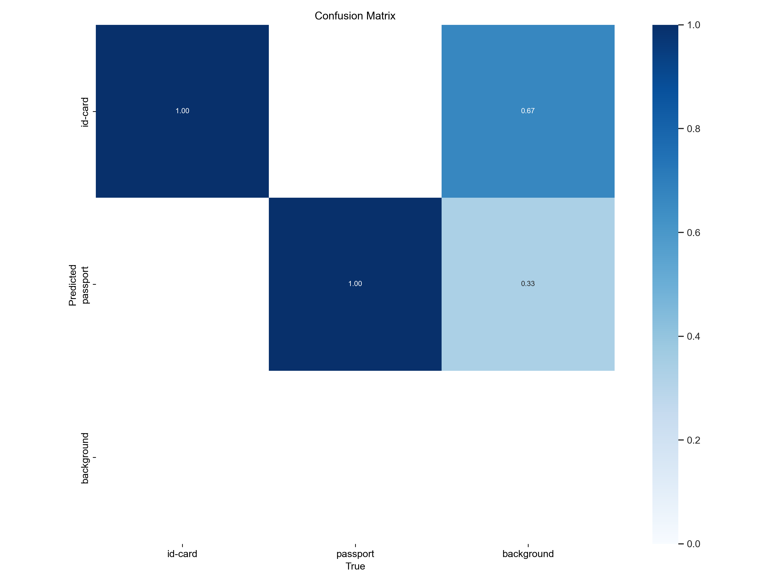
Improved Model 1 (+ Augmentation)
Validation Scores
Test Scores
 | ID Cards | Passport
Correctly identified | 95 | 99
Wrongly identified as the other class | 5 | 1
Wrongly identified as background | 0 | 0
Analysis for Train-Val:
This model performed much better – likely due to training data augmentation (see following EDA).
Still predicting background as object
Analysis for Test:
Better overall performance; performed better for passport prediction

Slide 19
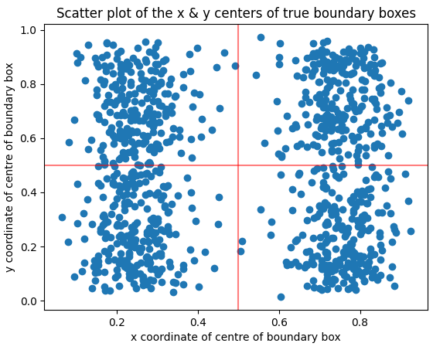
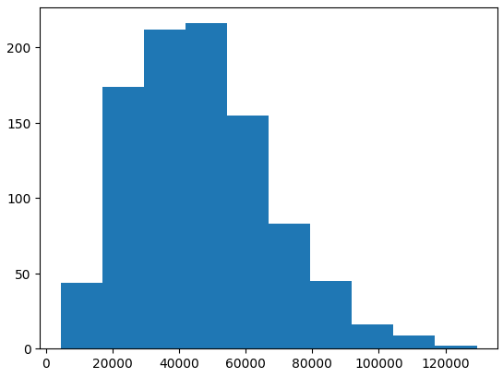
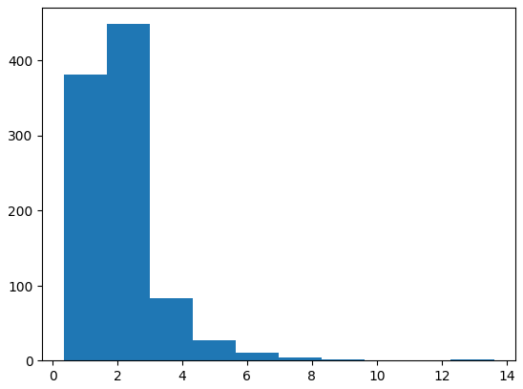
Augmented ID Cards has Better Distributed Samples
 | Scatterplot of Boundary Box centres | Histogram of Boundary Box Area | Histogram of Boundary Box Aspect Ratio
ID Cards (non-augmented)
ID Cards (augmented)
Shifted area towards lower sizes → more robust in identifying overall objects by training on cropped images
Same as area: cropped images shifted aspect ratios → more robust in identifying overall objects
Became more evenly distributed due to translation, mosaic, scale

Slide 20
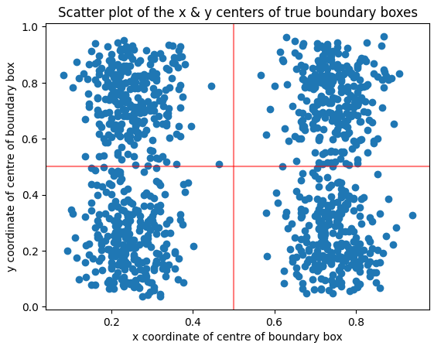
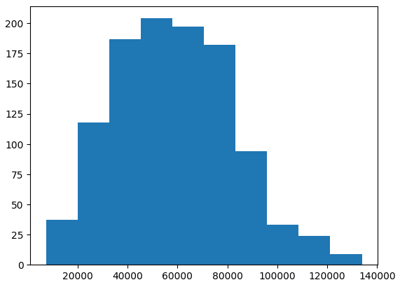
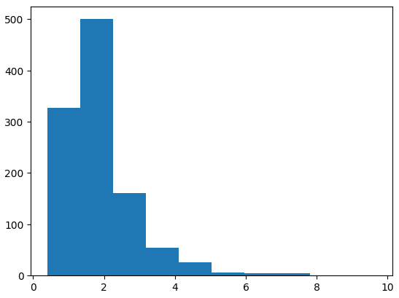
Same Improvements for Passports
 | Scatterplot of Boundary Box centres | Histogram of Boundary Box Area | Histogram of Boundary Box Aspect Ratio
Passport (non-augmented)
Passport (augmented)
Became more evenly distributed
Trained on cropped images → more robust in object detection

Slide 21
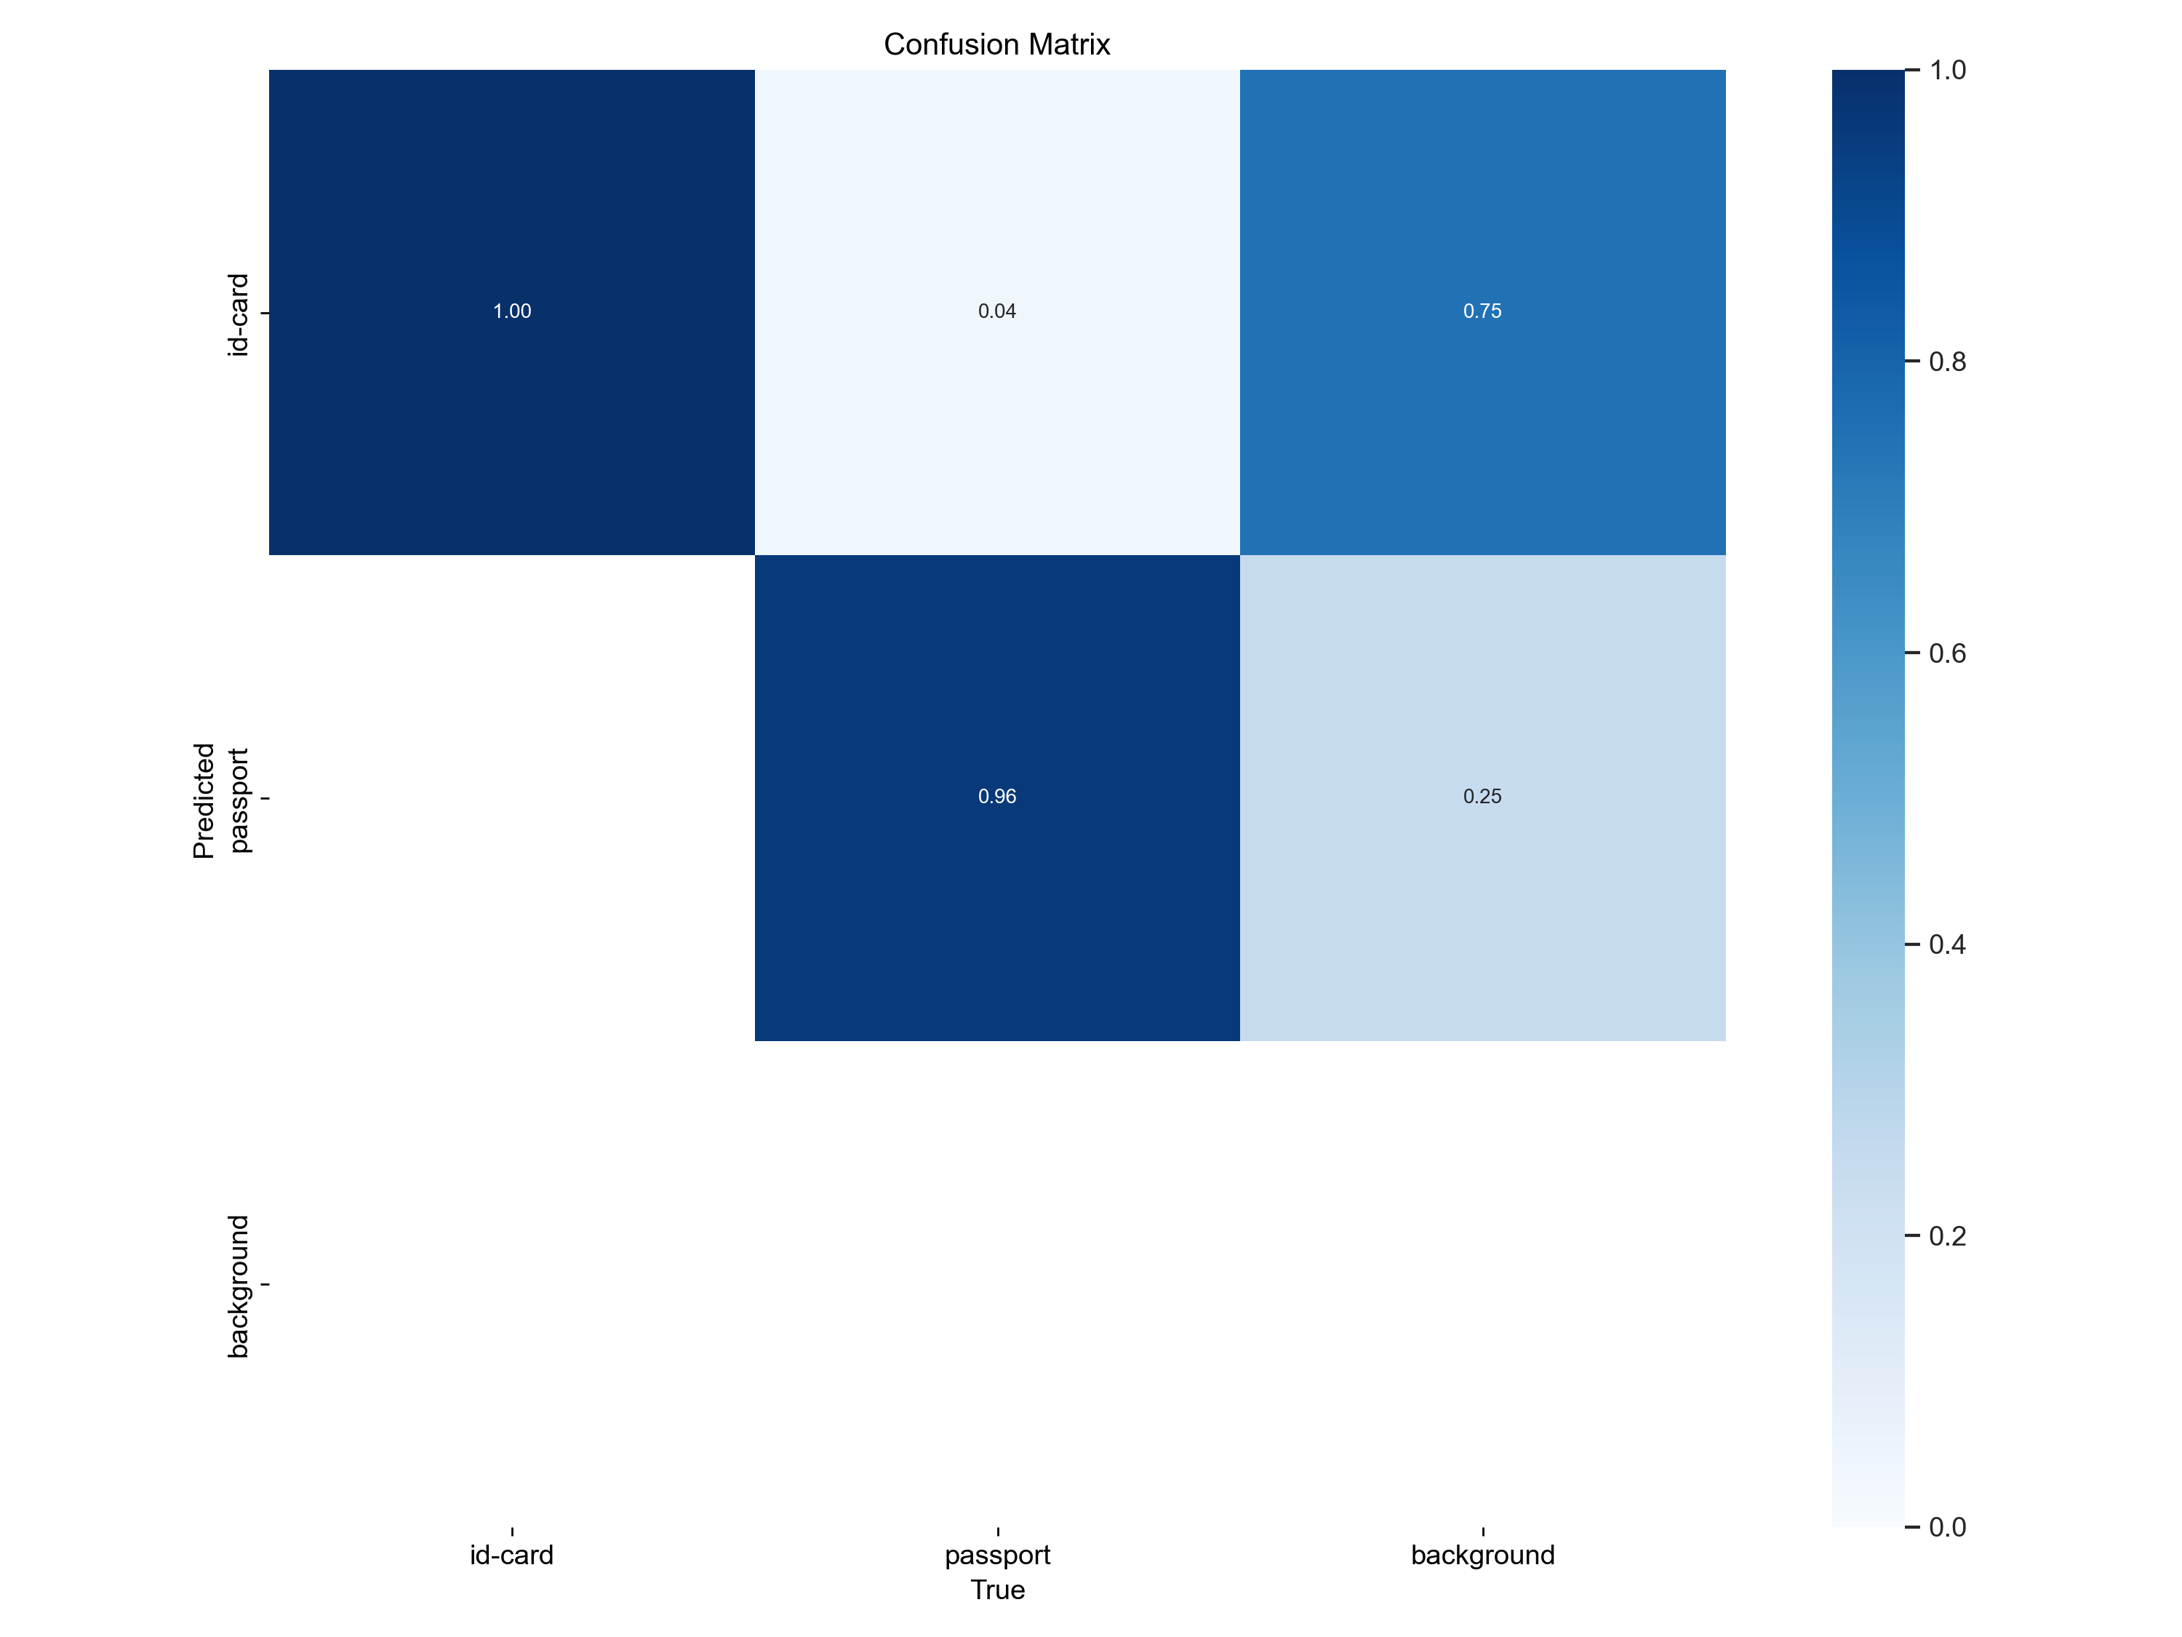
Improved Model 2 (+ Augmentation + Rotate + Shear)
Validation Scores
Test Scores
 | ID Cards | Passport
Correctly identified | 95 | 98
Wrongly identified as the other class | 3 | 2
Wrongly identified as background | 2 | 0
Analysis for Train-Val:
This model performed similar to improved model 1
Still predicting background as object
Analysis for Test:
Poorer performance than improved model 1 – likely due to excessive data augmentation on small dataset¹¹
[11] Excessive data augmentation lead to poorer model performance, because it introduces data noise (Ultralytics, Tencent)

Slide 22
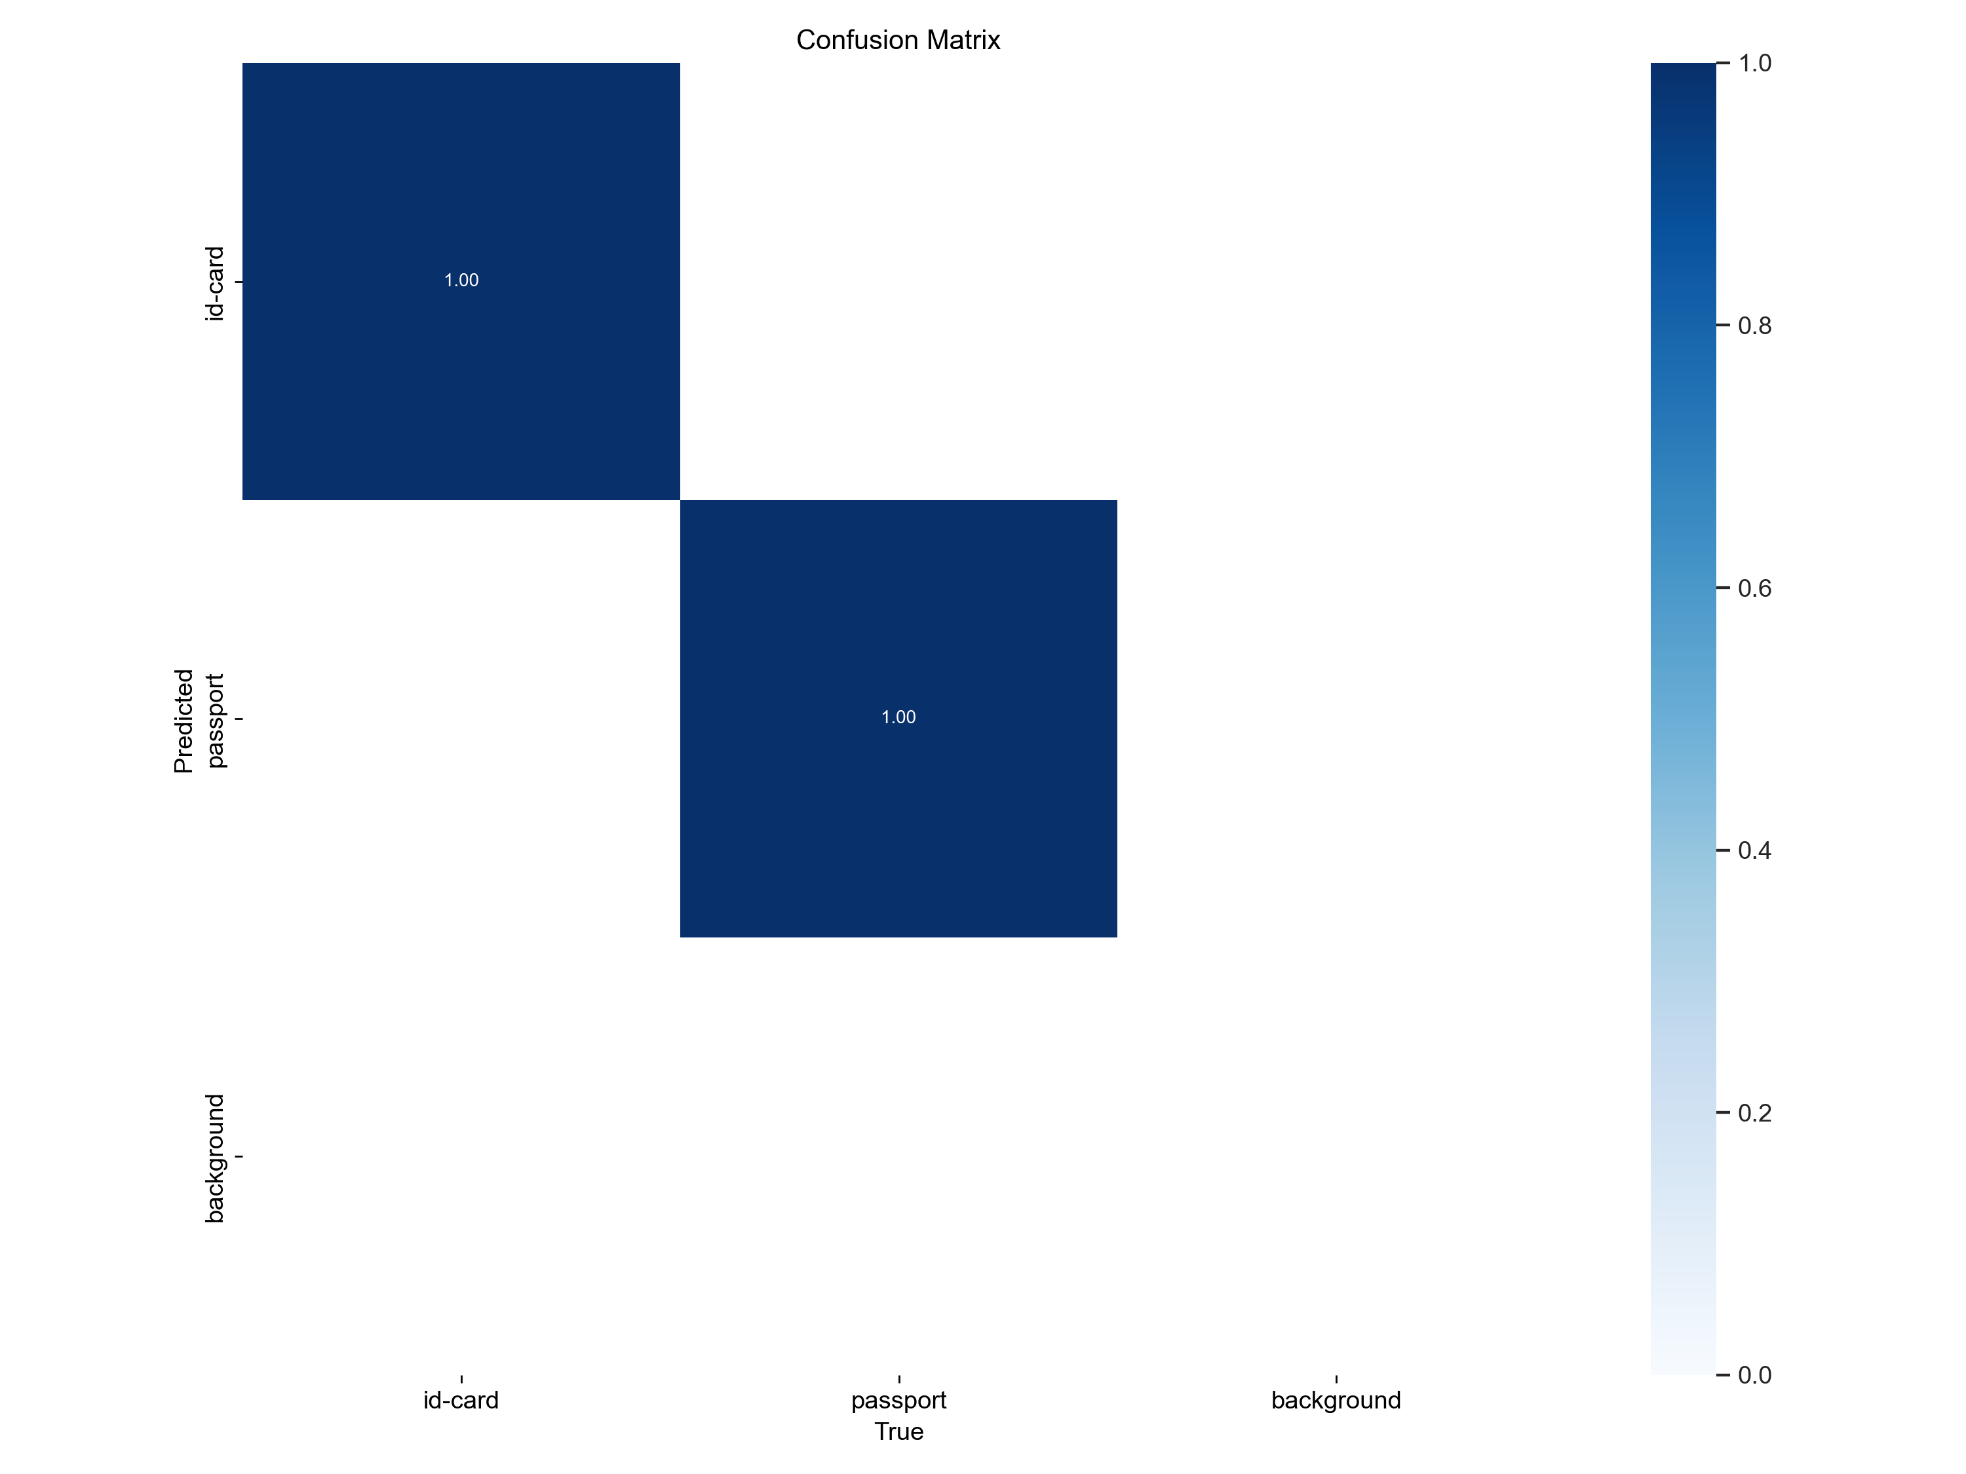
Improved Model 3 (+ Augmentation + 2x Training Data)
Validation Scores
Test Scores
 | ID Cards | Passport
Correctly identified | 96 | 100
Wrongly identified as the other class | 1 | 0
Wrongly identified as background | 3 | 0
Analysis for Train-Val:
This model performed well
Analysis for Test:
Best performance thus far, although only a small improvement from improved model 1
Increasing data size through augmentation can lead to some improvements¹²
[12] Small datasets can benefit from data augmentation techniques (The Analytics Club, Datacamp)

Slide 23
Model Test Performance Comparison
 | Baseline |  | Improved 1 |  | Improved 2 |  | Improved 3 *best performance*
 | ID Cards | Passport | ID Cards | Passport | ID Cards | Passport | ID Cards | Passport
Correctly identified | 99 | 62 | 95 | 99 | 95 | 98 | 96 | 100
Wrongly identified as the other class | 1 | 25 | 5 | 1 | 3 | 2 | 1 | 0
Wrongly identified as background | 0 | 13 | 0 | 0 | 2 | 0 | 3 | 0
Total correct predictions | 161 |  | 194 |  | 193 |  | 196
Total wrong predictions | 39 |  | 6 |  | 7 |  | 4

Slide 24
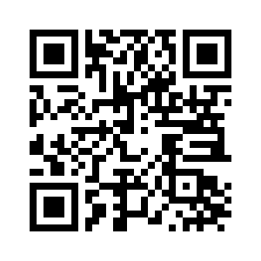
Streamlit Demonstration
Please scan
the QR code to access my Streamlit app!

Slide 25
04
Conclusion

Slide 26
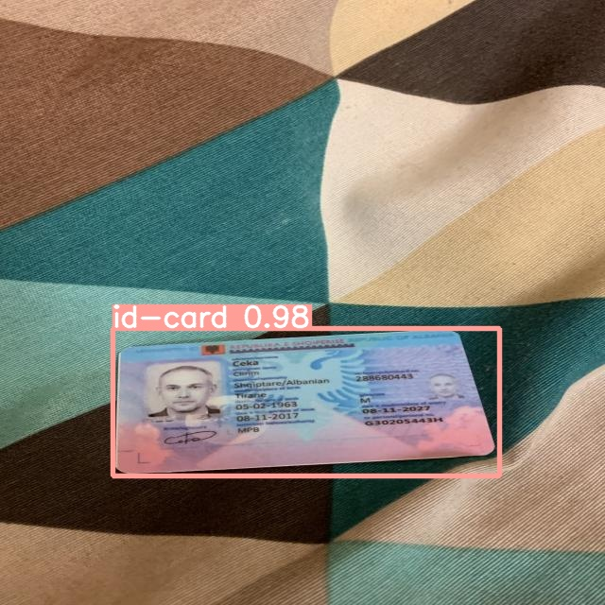
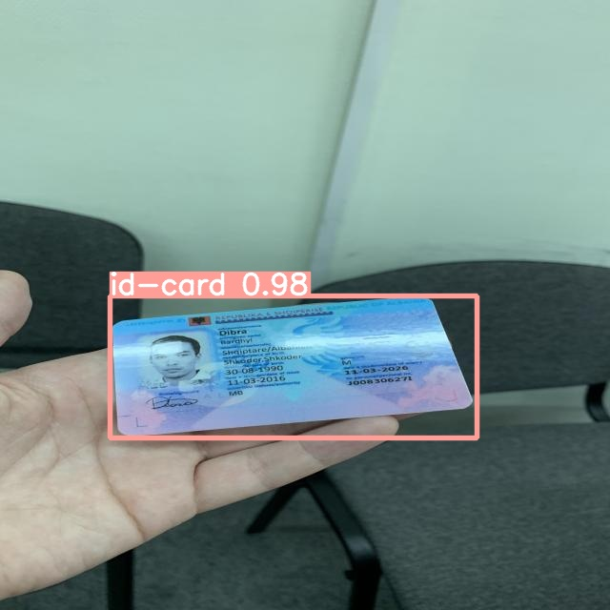
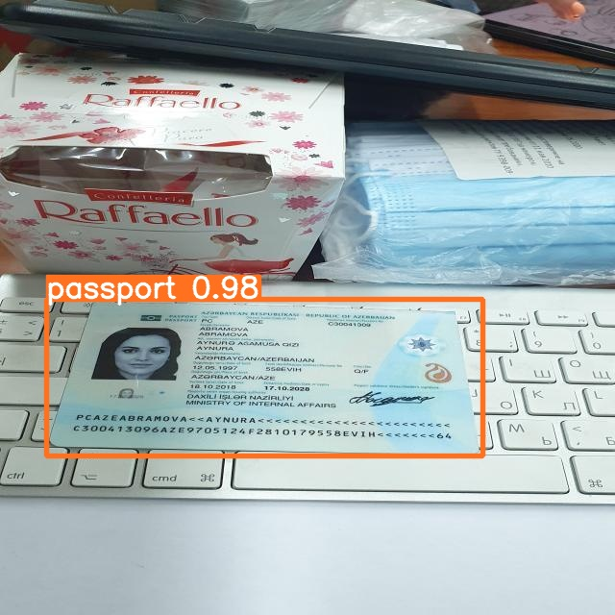
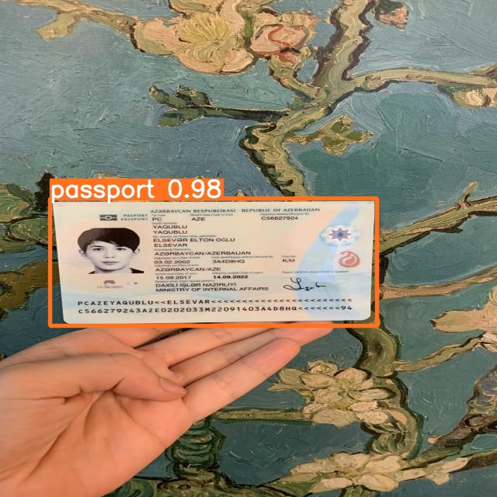
Summary
Problem statement
A digital bank in Singapore wants to expand its banking business into Indonesia, but faced the challenge of Indonesia not having digital national ID cards. The bank wants to avoid manual ID verification for account opening, because it leads to a poor customer experience
Results
As tasked by the bank, an object detection model was successfully developed with a test accuracy of 96% for ID cards and 100% for passports. The streamlit deployment also achieved a classification speed of ~3 seconds for each photo submission¹³.
[13] tested on both PC (using CPU) and mobile phone ( Samsung Galaxy S22+)

Slide 27
Limitations & Areas for Improvement
Limitations
Areas for improvement
Dataset used is too small even for transfer learning, likely leading to poor generalisation
Possibly limited performance on Southeast Asian ID documents (due to nature of dataset)
Current model is unable to discern quality of submissions (e.g. blur, too dark, too bright etc.)
Conduct proof-of-concept using real data (>= 1,500 images per class)
Use transfer learning to train on local dataset (i.e. start from developed weights)
Develop a multi-head¹⁴ model to conduct quality classification (each head to classify 1 type of quality)
[14] Cornell, Sep 2021, Marvik, Dec 2022

Slide 28
Thank You!
Do you have any questions?

Slide 29
Resources:
Theory | History of computer vision | Lil’log
 | Understanding MAP metric | Medium
 | Understanding labelling | SuperAnnotate
 | Understanding YOLOv3 | Paper
Computer vision workflow | Labelling with labelImg | Labelmg github Roboflow
 | Getting started with VS Code | VS Code
 | How to use YOLOv3 with Keras | Machine learning mastery
 | How to train YOLOv3 | Experiencor github Gilbert Tanner Kaggle
 | COCO dataset | COCO
Stretch goals | Multi-label CV using Keras | Analytics Vidhya
 | Streamlit deployment | thepbordin

Slide 30
Annex: Dataset
The digitally generated photos were printed and made into physical documents
These documents were then taken under these conditions:
Low lighting conditions (20 documents of each type)
Keyboard as a background (10 documents of each type)
Natural lighting, captured outdoors (10 documents of each type)
Table as a background (10 documents of each type)
Cloth with various textures as a background (10 documents of each type)
Text document as a background (10 documents of each type)
High projective distortions of the document (20 documents of each type)
Highlight from the sun or lamp hides a portion of the document (10 documents of each type)
Each country abide to these pre-set parameters:
80% are adults (18 – 60 years old)
10% are seniors (>60)
10% are children, adolescents (<= 17)
50:50 male-female ratio
Source: MIDV-2020: A Comprehensive Benchmark Dataset for Identity Document Analysis

Slide 31
Annex: Brief History of YOLO
YOLO (You Only Look Once) is a popular object detection and image segmentation model developed by Joseph Redmon and Ali Farhadi at the University of Washington. The first version of YOLO was released in 2015 and quickly gained popularity due to its high speed and accuracy.
YOLOv2 was released in 2016 and improved upon the original model by incorporating batch normalization, anchor boxes, and dimension clusters. YOLOv3 was released in 2018 and further improved the model's performance by using a more efficient backbone network, adding a feature pyramid, and making use of focal loss.
In 2020, YOLOv4 was released which introduced a number of innovations such as the use of Mosaic data augmentation, a new anchor-free detection head, and a new loss function.
In 2021, Ultralytics released YOLOv5, which further improved the model's performance and added new features such as support for panoptic segmentation and object tracking. In addition, Ultralytics maintains a public open-source repository to provide guides and tutorials on the installation and use of YOLOv5 – making YOLOv5 easy to build and use.
Source: Ultralytics

Slide 32
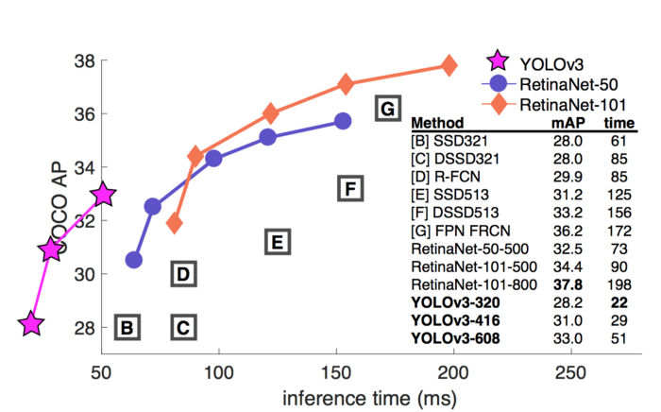
Annex: Why YOLO and Not Other Models?
YOLO is a single-shot detector* that uses a fully convolutional neural network (CNN) to process an image. It processes an entire image in a single pass, making them computationally efficient.
YOLO excels in detection speed, enabling object detection in real-time videos
Source: YOLOv3 paper
*Single-shot object detection uses a single pass of the input image to make predictions about the presence and location of objects in the image. Whereas a two-shot object detection uses two passes of the input image to make predictions about the presence and location of objects: the first pass is used to generate a set of proposals or potential object locations, and the second pass is used to refine these proposals and make final predictions

Slide 33
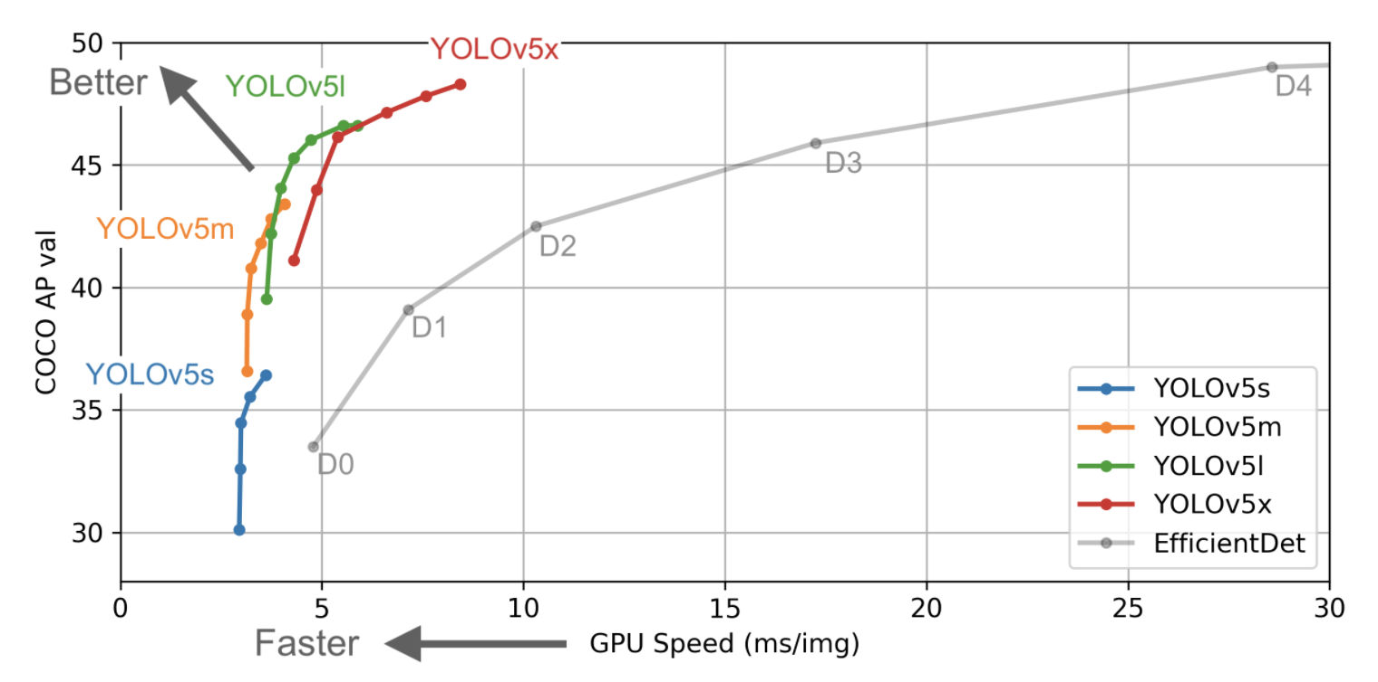
Annex: Why YOLOv5l (Large)?
YOLOv5l offers a good balance between performance and speed of inference
Source: Ultraytics

Slide 34
Annex: YOLOv5 Architecture
The YOLO network consists of three main pieces.
Backbone: A convolutional neural network that aggregates and forms image features at different granularities.
Neck: A series of layers to mix and combine image features to pass them forward to prediction.
Head: Consumes features from the neck and takes box and class prediction steps.
https://towardsai.net/p/computer-vision/yolo-v5%E2%80%8A-%E2%80%8Aexplained-and-demystified
https://iq.opengenus.org/yolov5/
https://blog.roboflow.com/yolov5-improvements-and-evaluation/

Slide 35
Annex: Single-Shot Object Detection
asd

Slide 36
Annex: YOLOv5 Loss Functions
Classes loss(BCE loss)
Objectness loss(BCE loss)
Location loss(CIoU loss)

Slide 37
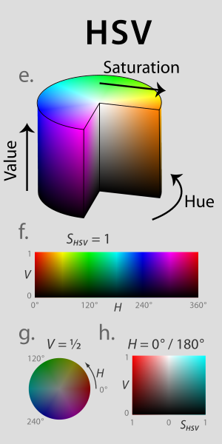
Annex: Colour Augmentation
Saturation: intensity of colour in an image. Highly saturated images have vivid, rich colours and lowly saturated images are pale and washed-out
Hue: attribute of a visible light due to which it is differentiated from or similar to the primary colors: red, green and blue
Value (a.k.a brightness): the perception of how intense the light coming from a screen is
Source: Techopedia for saturation, hue, value; Wikipedia

Slide 38
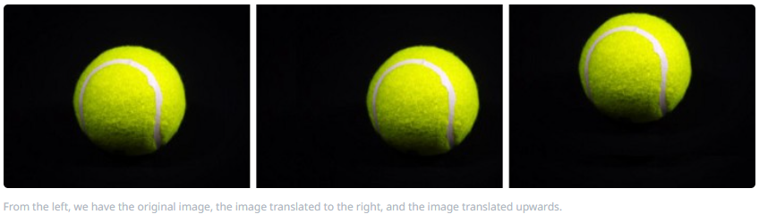
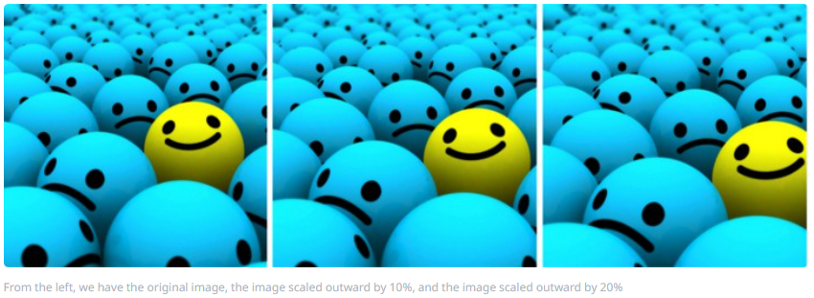
Annex: Dimension Augmentation (1)
Translation: vertical / horizontal shift of object
Scale: altering the image size to be larger (i.e. zoom in) or smaller (i.e. zoom out) than the original
Source: Nanonets

Slide 39
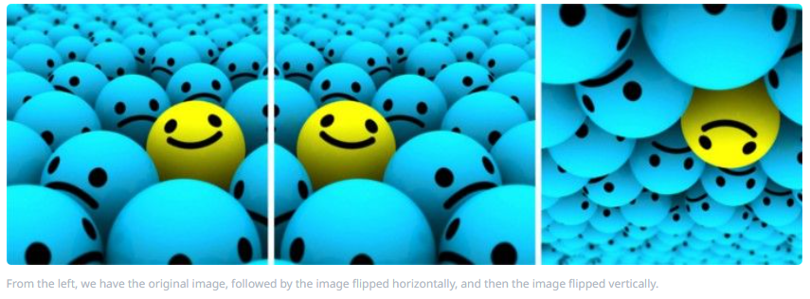
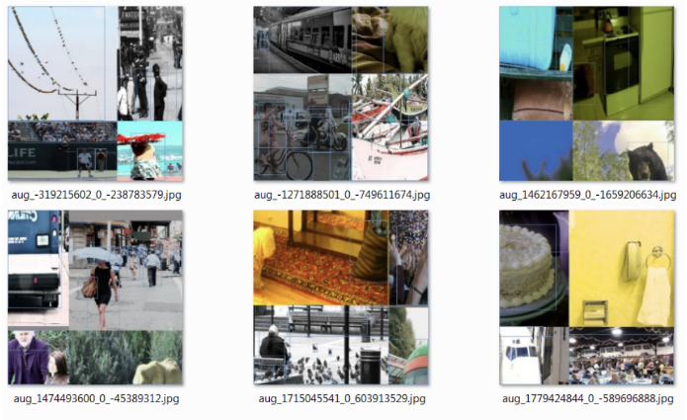
Annex: Dimension Augmentation (2)
Flip left-right: flipping the image horizontally
Mosaic: combining a corner of an image with 3 separate corners of 3 other images
Source: Nanonets, Roboflow

Slide 40
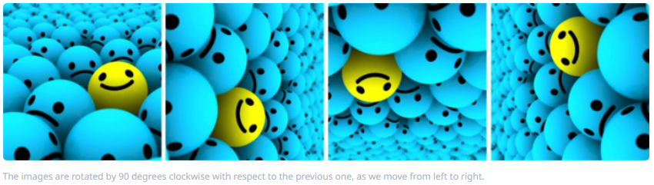

Annex: Dimension Augmentation (3)
Rotate: turn the image around the centre of the image as its rotating axis
Shear: displace the image horizontally to different degree, transforming the image into a parallelogram
Source: Nanonets, Paperspaceblog

Slide 41
Annex: Auto Learning Bounding Box Anchors
asd

Slide 42
Annex: Non-Maximum Suppression
asd

Slide 43

Annex: Intersection over Union (IoU)
Overview
IoU is a popular metric to measure localization accuracy and calculate localization errors in object detection models.
Detailed explanation
The formula for IoU is show on the right
E.g. IoU score of 0.54 = 54% overlap between the two boxes
A threshold can be set for the IoU score, to decide how much overlap constitutes a ‘positive’ classification
Ground truth bounding box
Predicted bounding box
Source: v7labs

Slide 44
Annex: Mean Average Precision (mAP)
Overview
mAP is a popular metric that measures the
Detailed explanation
Average Precision (AP) is calculated as the area under a precision vs. recall curve for a set of predictions.
Recall and precision offer a trade-off that is graphically represented into a curve by varying the classification threshold. The area under this precision vs. recall curve gives us the Average Precision per class for the model. The average of this value, taken over all classes, is called mean Average Precision (mAP).
https://blog.roboflow.com/mean-average-precision/
https://blog.paperspace.com/mean-average-precision/#:~:text=To%20evaluate%20object%20detection%20models,model%20is%20in%20its%20detections.
Source: v7labs

Slide 45




Annex: Modelling Train-Val Results
Baseline Model:
Improved Model 1:
Improved Model 2:
Improved Model 3:

